Slide 1
NONPARAMETRIC ANALYSIS: A Primer
Dr. Olga Korosteleva, CSULB
Southern California R User Group
February 26, 2022

Slide 2
CONTENTS
01
Introduction. Why nonparametric?
02
Wilcoxon Rank-sum Test
03
Kolmogorov-Smirnov Test
04
Kruskal-Wallis H-test
05
Spearman Rank Correlation Coefficient
06
Fisher Exact Test
07
Loess Regression
08
Bootstrap Method of Estimation
2

Slide 3
01
Introduction. Why nonparametric?
► Classical statistical inference is typically valid for normally distributed variables, or when
sample sizes are large for the Central Limit Theorem to work, or when the underlying distribution
is known. Then we can construct confidence intervals, conduct hypotheses testing, and fit
regression models.
► But what if the sample size is small (less than 30), and/or the distribution is unknown, or the
data collected for regression analysis clearly exhibit periodic behavior? In this case,
nonparametric statistical techniques may be used.
► Statistical inference based on a known distribution is sometimes referred to as parametric
statistics because only parameters need to be estimated. In the nonparametric world, there are no
parameters to be estimated.
3

Slide 4
Wilcoxon Rank-sum Test
02
4

Slide 5
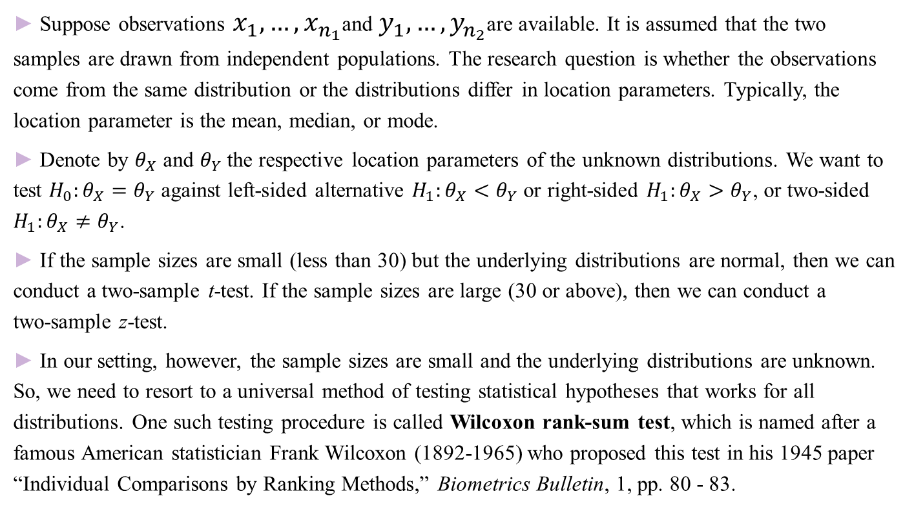
Wilcoxon Rank-sum Test
02
► Suppose observations $x_{1}, …, x_{n_{1}}$and $y_{1}, …, y_{n_{2}}$are available. It is assumed that the two
samples are drawn from independent populations. The research question is whether the observations
come from the same distribution or the distributions differ in location parameters. Typically, the
location parameter is the mean, median, or mode.
► Denote by $θ_{X}$ and $θ_{Y}$the respective location parameters of the unknown distributions. We want to
test $H_{0}:θ_{X}=θ_{Y}$ against left-sided alternative $H_{1}:θ_{X}<θ_{Y}$ or right-sided $H_{1}:θ_{X}>θ_{Y}$, or two-sided
$H_{1}:θ_{X}≠θ_{Y}$.
► If the sample sizes are small (less than 30) but the underlying distributions are normal, then we can
conduct a two-sample t-test. If the sample sizes are large (30 or above), then we can conduct a
two-sample z-test.
► In our setting, however, the sample sizes are small and the underlying distributions are unknown.
So, we need to resort to a universal method of testing statistical hypotheses that works for all
distributions. One such testing procedure is called Wilcoxon rank-sum test, which is named after a
famous American statistician Frank Wilcoxon (1892-1965) who proposed this test in his 1945 paper
“Individual Comparisons by Ranking Methods,” Biometrics Bulletin, 1, pp. 80 - 83.
5

Slide 6
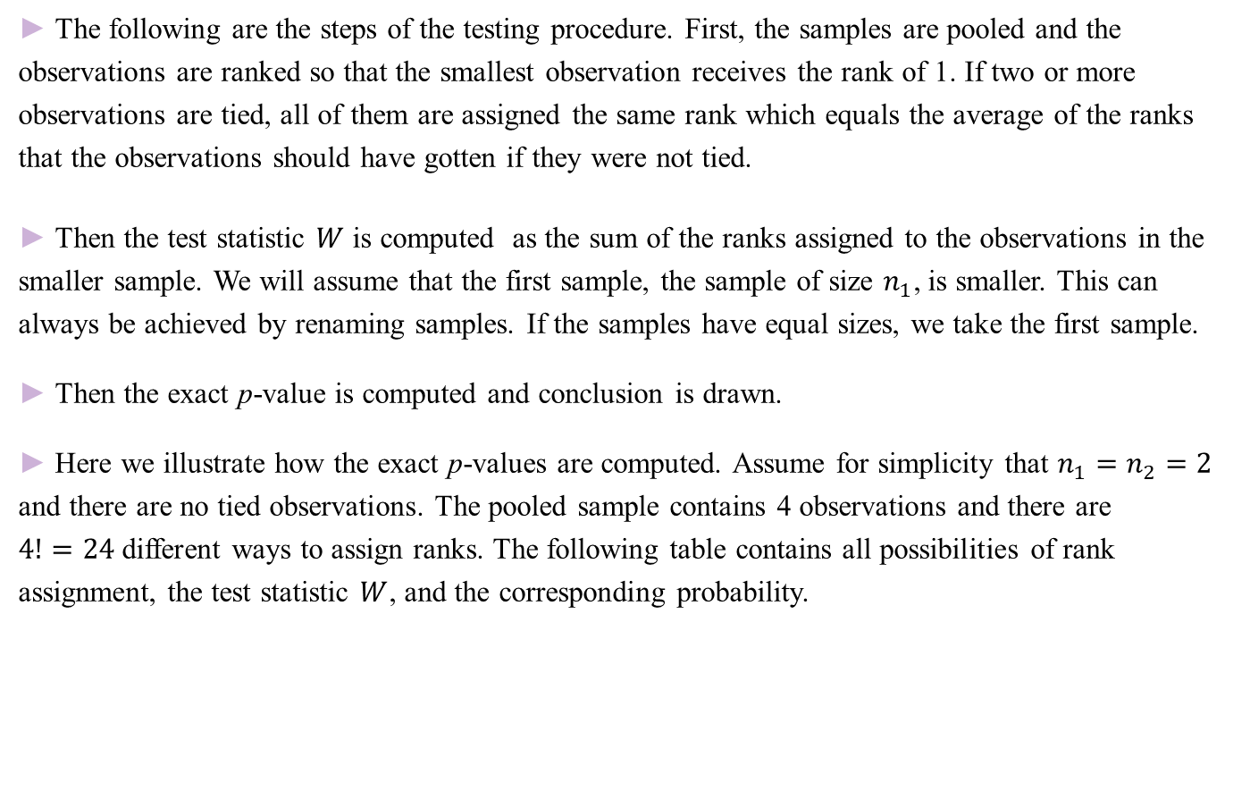
Wilcoxon Rank-sum Test
02
► The following are the steps of the testing procedure. First, the samples are pooled and the
observations are ranked so that the smallest observation receives the rank of 1. If two or more
observations are tied, all of them are assigned the same rank which equals the average of the ranks
that the observations should have gotten if they were not tied.
► Then the test statistic $W$ is computed as the sum of the ranks assigned to the observations in the
smaller sample. We will assume that the first sample, the sample of size $n_{1}$, is smaller. This can
always be achieved by renaming samples. If the samples have equal sizes, we take the first sample.
► Then the exact p-value is computed and conclusion is drawn.
► Here we illustrate how the exact p-values are computed. Assume for simplicity that $n_{1}=n_{2}=2$
and there are no tied observations. The pooled sample contains 4 observations and there are
$4!=24$different ways to assign ranks. The following table contains all possibilities of rank
assignment, the test statistic $W$, and the corresponding probability.
6

Slide 7
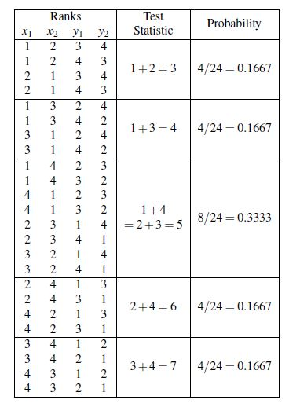
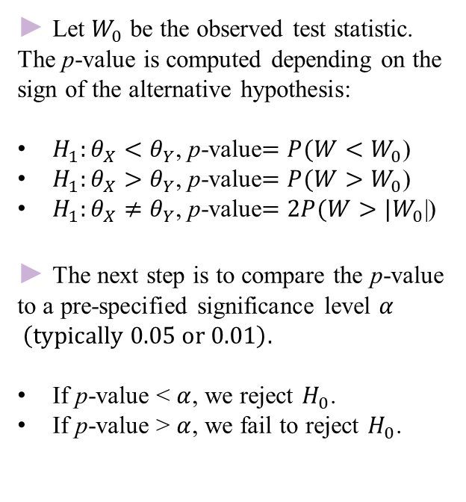
Wilcoxon Rank-sum Test
02
► Let $W_{0}$ be the observed test statistic. The p-value is computed depending on the sign of the alternative hypothesis:
$H_{1}:θ_{X}<θ_{Y}$, p-value$=P(W<W_{0}$)
$H_{1}:θ_{X}>θ_{Y}$, p-value$=P(W>W_{0}$)
$H_{1}:θ_{X}≠θ_{Y}$, p-value$=2P(W>{|W}_{0}$|)
► The next step is to compare the p-value to a pre-specified significance level $α \left(typically 0.05 or 0.01\right).$
If p-value < $α$, we reject $H_{0}$.
If p-value > $α$, we fail to reject $H_{0}$.
7

Slide 8
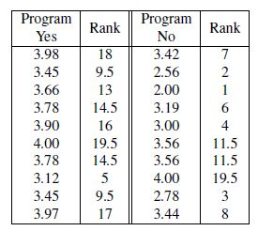
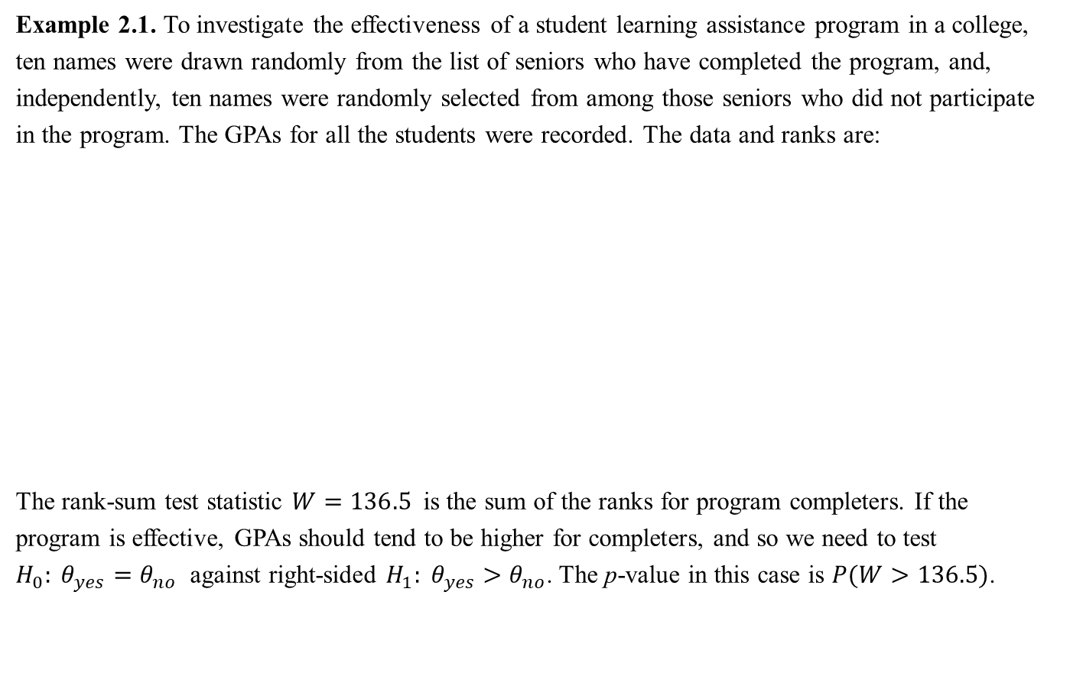
Example of Wilcoxon Rank-sum Test
02
Example 2.1. To investigate the effectiveness of a student learning assistance program in a college,
ten names were drawn randomly from the list of seniors who have completed the program, and,
independently, ten names were randomly selected from among those seniors who did not participate
in the program. The GPAs for all the students were recorded. The data and ranks are:
The rank-sum test statistic $W=136.5$is the sum of the ranks for program completers. If the
program is effective, GPAs should tend to be higher for completers, and so we need to test
$H_{0}: θ_{yes}=θ_{no}$ against right-sided $H_{1}: θ_{yes}>θ_{no}$. The p-value in this case is $P(W>136.5)$.
8

Slide 9
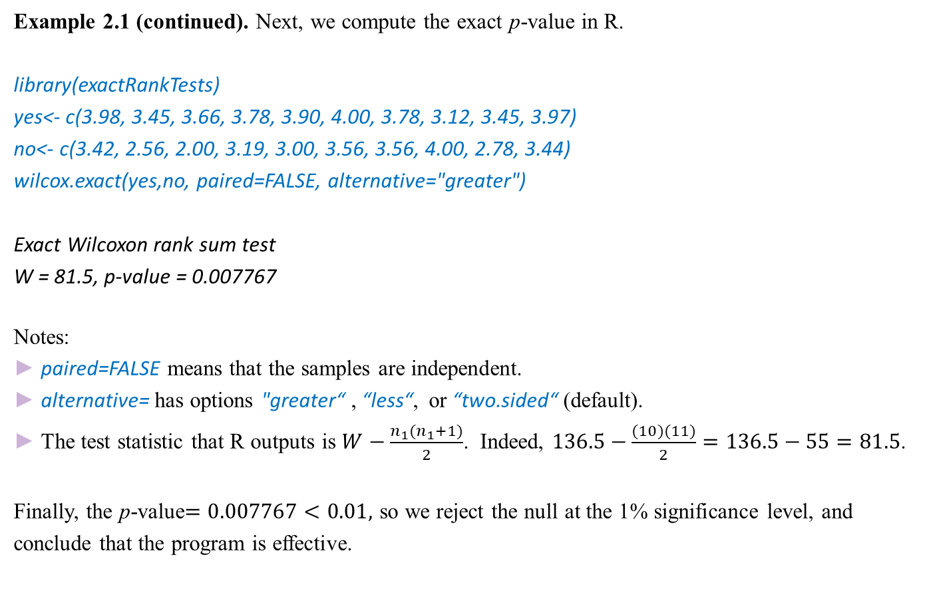
Example of Wilcoxon Rank-sum Test
02
Example 2.1 (continued). Next, we compute the exact p-value in R.
library(exactRankTests)
yes<- c(3.98, 3.45, 3.66, 3.78, 3.90, 4.00, 3.78, 3.12, 3.45, 3.97)
no<- c(3.42, 2.56, 2.00, 3.19, 3.00, 3.56, 3.56, 4.00, 2.78, 3.44)
wilcox.exact(yes,no, paired=FALSE, alternative="greater")
Exact Wilcoxon rank sum test
W = 81.5, p-value = 0.007767
Notes:
► paired=FALSE means that the samples are independent.
► alternative= has options "greater“ , “less“, or “two.sided“ (default).
► The test statistic that R outputs is $W−\frac{n_{1}(n_{1}+1)}{2}$. Indeed, $136.5−\frac{(10)(11)}{2}=136.5−55=81.5$.
Finally, the p-value$=0.007767<0.01,$ so we reject the null at the 1% significance level, and
conclude that the program is effective.
9

Slide 10
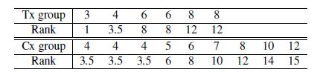
Exercise for Wilcoxon Rank-sum Test
02
Exercise 2.1. The performance of a new wound-healing bioimplant is studied retrospectively. In a
medical center, the soft tissue in the foot and ankle was repaired per standard procedure and
augmented with the bioimplant in six subjects (Tx group), whereas it was repaired but not augmented
in nine subjects (Cx group). Time to full weight-bearing (in weeks) is available for all subjects. The
research hypothesis is that the bioimplant is effective. The observations and their ranks are given in
the following table:
Specify the hypotheses and compute the test statistic.
Use R to produce the exact p-value.
Draw conclusion.
10

Slide 11
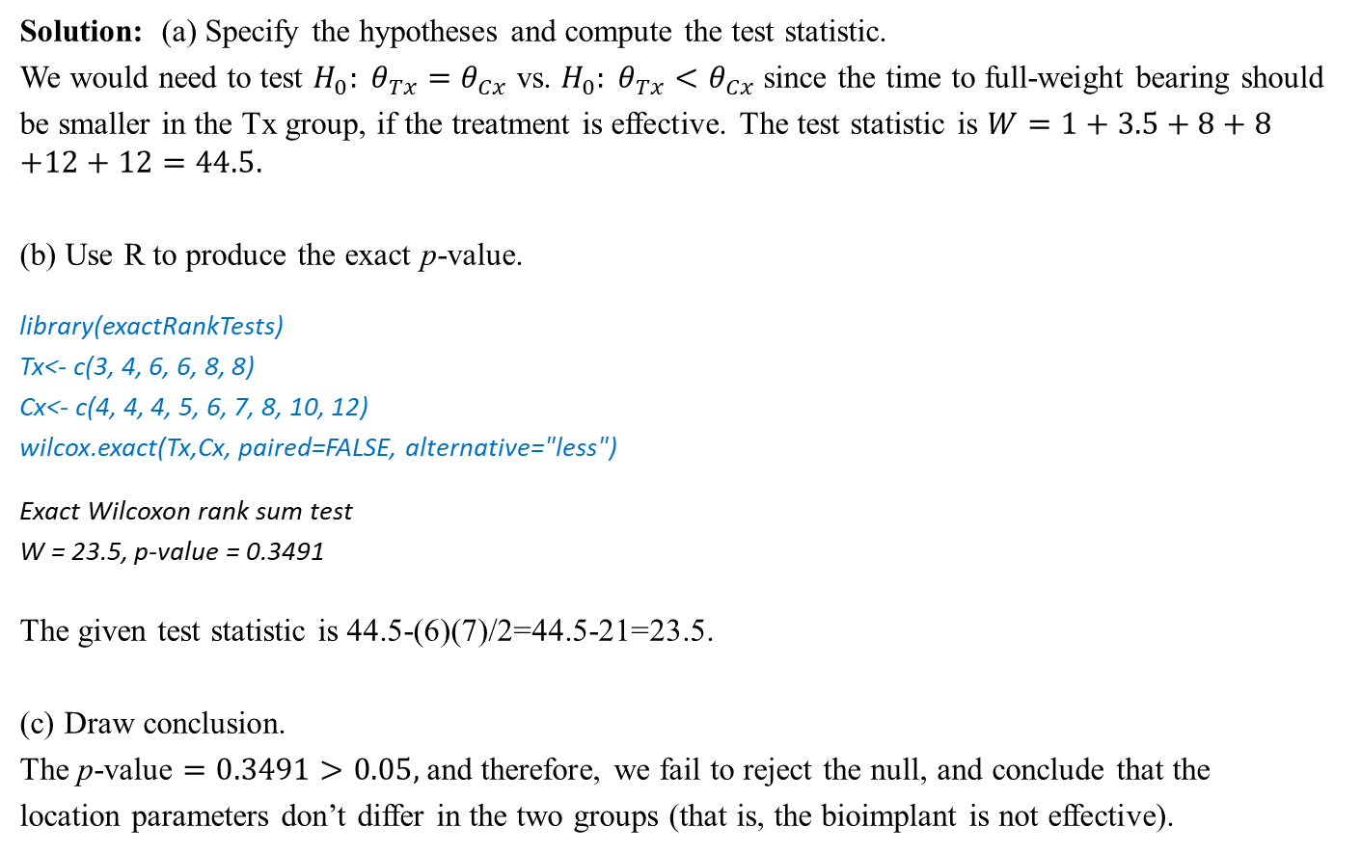
Exercise for Wilcoxon Rank-sum Test
02
Solution: (a) Specify the hypotheses and compute the test statistic.
We would need to test $H_{0}: θ_{Tx}=θ_{Cx}$ vs. $H_{0}: θ_{Tx}<θ_{Cx}$ since the time to full-weight bearing should
be smaller in the Tx group, if the treatment is effective. The test statistic is $W=1+3.5+8+8$
$$+12+12=44.5.$$
(b) Use R to produce the exact p-value.
library(exactRankTests)
Tx<- c(3, 4, 6, 6, 8, 8)
Cx<- c(4, 4, 4, 5, 6, 7, 8, 10, 12)
wilcox.exact(Tx,Cx, paired=FALSE, alternative="less")
Exact Wilcoxon rank sum test
W = 23.5, p-value = 0.3491
The given test statistic is 44.5-(6)(7)/2=44.5-21=23.5.
(c) Draw conclusion.
The p-value $=0.3491>0.05,$and therefore, we fail to reject the null, and conclude that the
location parameters don’t differ in the two groups (that is, the bioimplant is not effective).
11

Slide 12
Kolmogorov-Smirnov Test
03
12

Slide 13
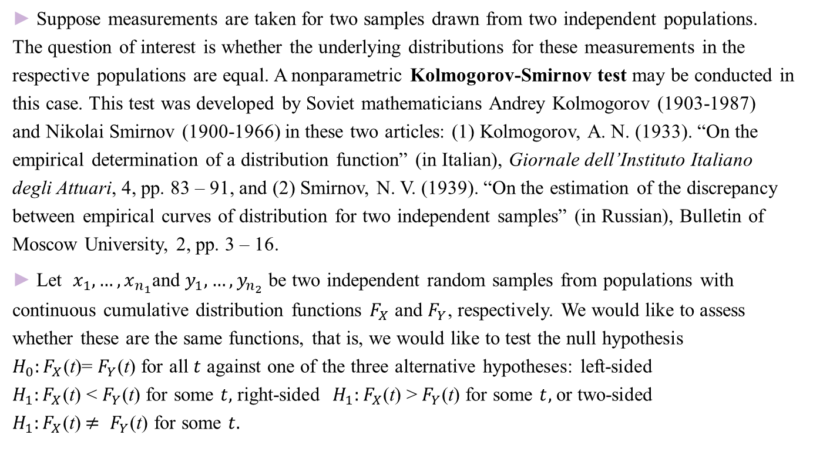
Kolmogorov-Smirnov Test
03
► Suppose measurements are taken for two samples drawn from two independent populations.
The question of interest is whether the underlying distributions for these measurements in the
respective populations are equal. A nonparametric Kolmogorov-Smirnov test may be conducted in
this case. This test was developed by Soviet mathematicians Andrey Kolmogorov (1903-1987)
and Nikolai Smirnov (1900-1966) in these two articles: (1) Kolmogorov, A. N. (1933). “On the
empirical determination of a distribution function” (in Italian), Giornale dell’Instituto Italiano
degli Attuari, 4, pp. 83 – 91, and (2) Smirnov, N. V. (1939). “On the estimation of the discrepancy
between empirical curves of distribution for two independent samples” (in Russian), Bulletin of
Moscow University, 2, pp. 3 – 16.
► Let $x_{1}, …, x_{n_{1}}$and $y_{1}, …, y_{n_{2}}$ be two independent random samples from populations with
continuous cumulative distribution functions $F_{X}$ and $F_{Y}$, respectively. We would like to assess
whether these are the same functions, that is, we would like to test the null hypothesis
$H_{0}:F_{X}$(t)= $F_{Y}$(t) for all $t$ against one of the three alternative hypotheses: left-sided
$H_{1}:F_{X}$(t) < $F_{Y}$(t) for some $t,$ right-sided $H_{1}:F_{X}$(t) >${ F}_{Y}$(t) for some $t,$ or two-sided
$H_{1}:F_{X}$(t)$≠ F_{Y}$(t) for some $t.$
13

Slide 14
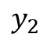
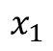
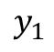
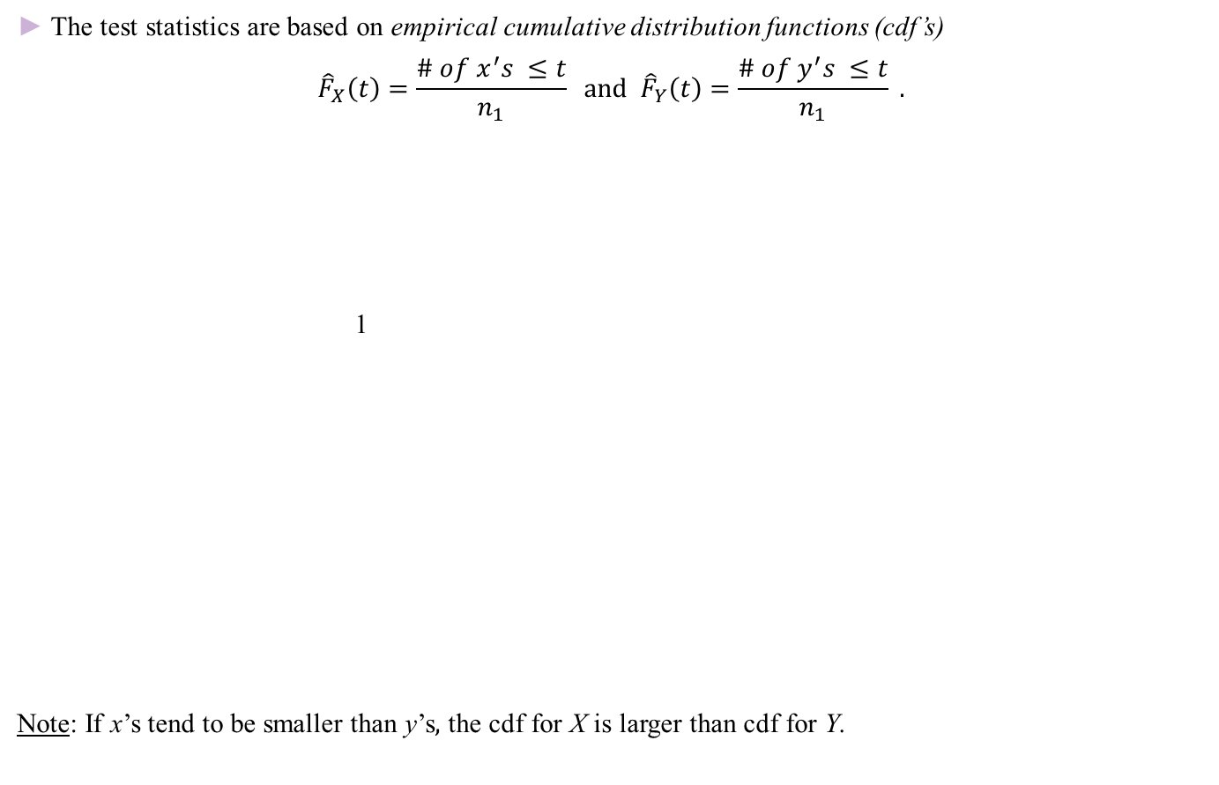
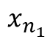
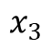
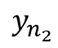
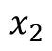
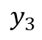
Kolmogorov-Smirnov Test
03
► The test statistics are based on empirical cumulative distribution functions (cdf’s)
$${\hat{F}}_{X}\left(t\right)=\frac{\# of x^{′}s ≤t}{n_{1}} and {\hat{F}}_{Y}\left(t\right)=\frac{\# of y^{′}s ≤t}{n_{1}} .$$
1
Note: If x’s tend to be smaller than y’s$,$ the cdf for X is larger than cdf for Y.
$$x_{1}$$
$$x_{2}$$
$$y_{1}$$
$$x_{3}$$
$$y_{2}$$
$$y_{3}$$
$$x_{n_{1}}$$
$$y_{n_{2}}$$
14

Slide 15
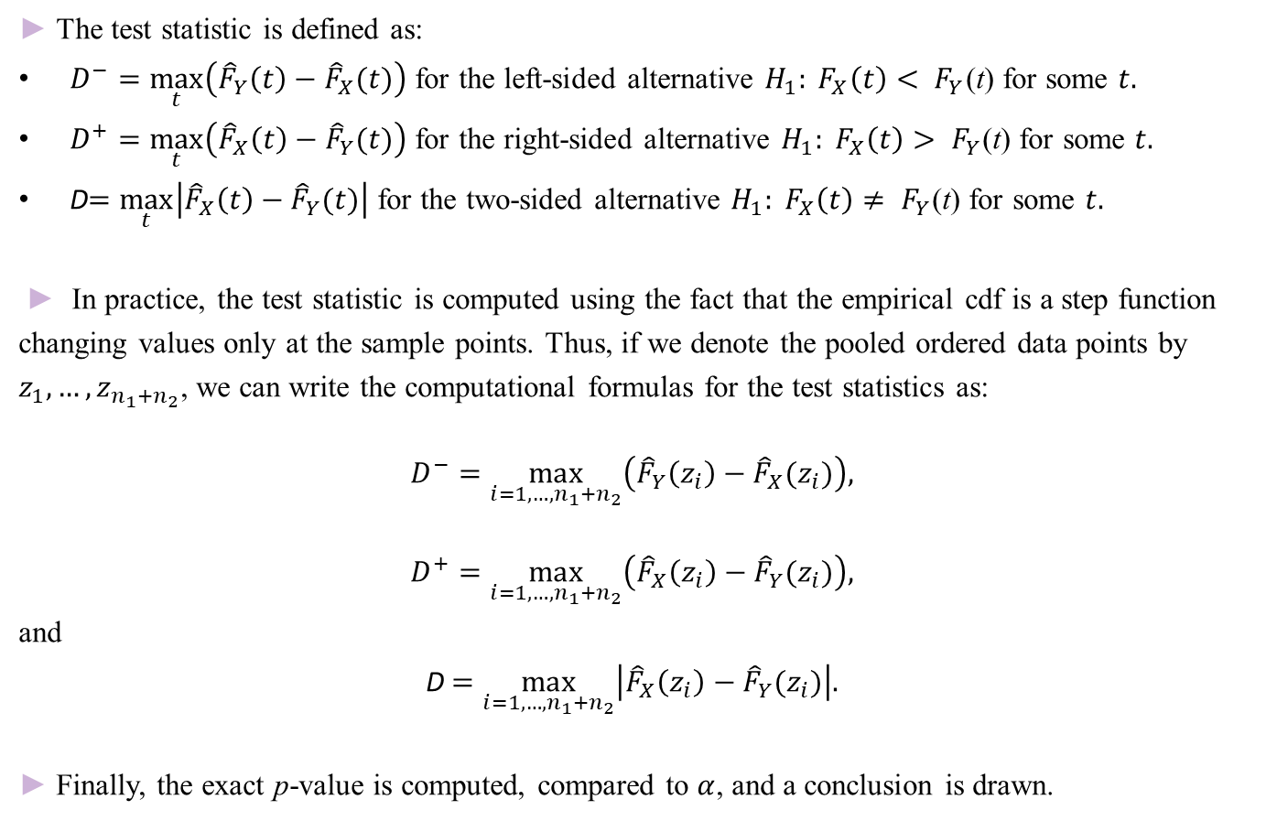
Kolmogorov-Smirnov Test
03
► The test statistic is defined as:
$D^{−}=\max_{t}\left({\hat{F}}_{Y}\left(t\right)−{\hat{F}}_{X}(t)\right)$ for the left-sided alternative $H_{1}: F_{X}\left(t\right)< F_{Y}$(t) for some $t.$
$D^{+}=\max_{t}\left({\hat{F}}_{X}\left(t\right)−{\hat{F}}_{Y}(t)\right)$ for the right-sided alternative $H_{1}: F_{X}\left(t\right)> F_{Y}$(t) for some $t.$
D$=\max_{t}\left|{\hat{F}}_{X}\left(t\right)−{\hat{F}}_{Y}(t)\right|$ for the two-sided alternative $H_{1}: F_{X}\left(t\right)≠ F_{Y}$(t) for some $t.$
► In practice, the test statistic is computed using the fact that the empirical cdf is a step function
changing values only at the sample points. Thus, if we denote the pooled ordered data points by
$z_{1}, …, z_{n_{1}+n_{2}}$, we can write the computational formulas for the test statistics as:
$$D^{−}=\max_{i=1, …, n_{1}+n_{2}}\left({\hat{F}}_{Y}\left(z_{i}\right)−{\hat{F}}_{X}(z_{i})\right),$$
$$D^{+}=\max_{i=1, …, n_{1}+n_{2}}\left({\hat{F}}_{X}\left(z_{i}\right)−{\hat{F}}_{Y}(z_{i})\right),$$
and
D $=\max_{i=1, …, n_{1}+n_{2}}\left|{\hat{F}}_{X}\left(z_{i}\right)−{\hat{F}}_{Y}(z_{i})\right|.$
► Finally, the exact p-value is computed, compared to $α$, and a conclusion is drawn.
15

Slide 16
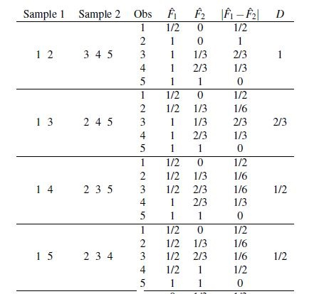
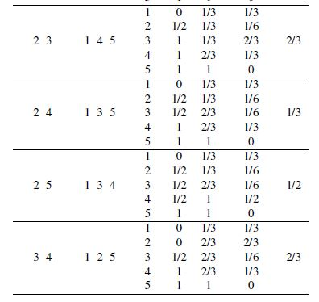
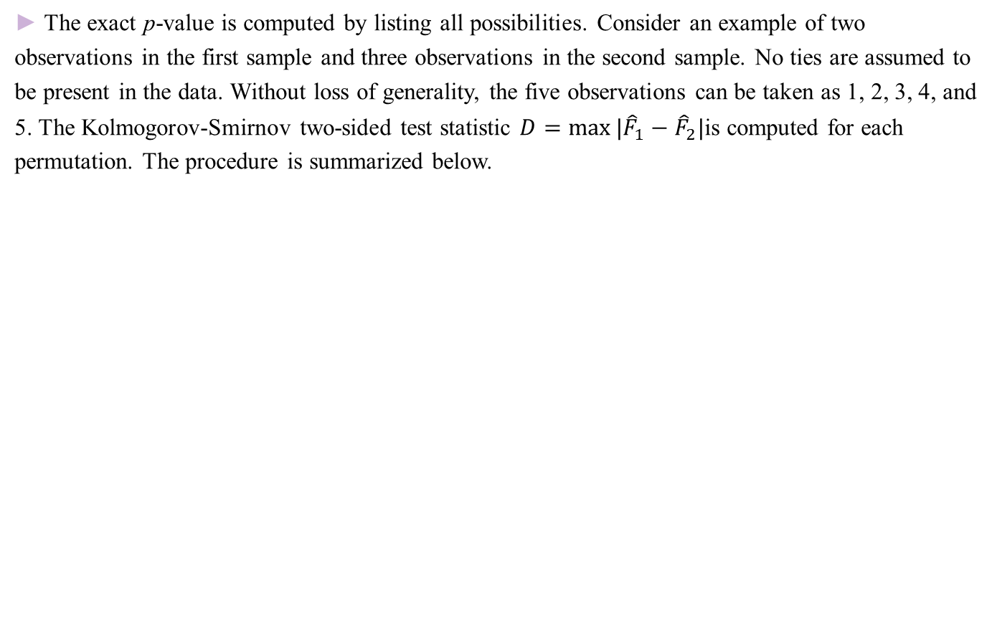
Kolmogorov-Smirnov Test
03
► The exact p-value is computed by listing all possibilities. Consider an example of two
observations in the first sample and three observations in the second sample. No ties are assumed to
be present in the data. Without loss of generality, the five observations can be taken as 1, 2, 3, 4, and
5. The Kolmogorov-Smirnov two-sided test statistic $D=\max{|{\hat{F}}_{1}−{\hat{F}}_{2}|}$is computed for each
permutation. The procedure is summarized below.
16

Slide 17
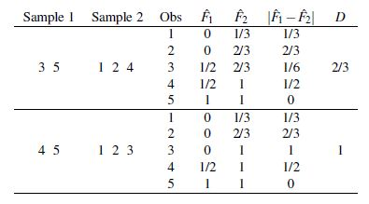
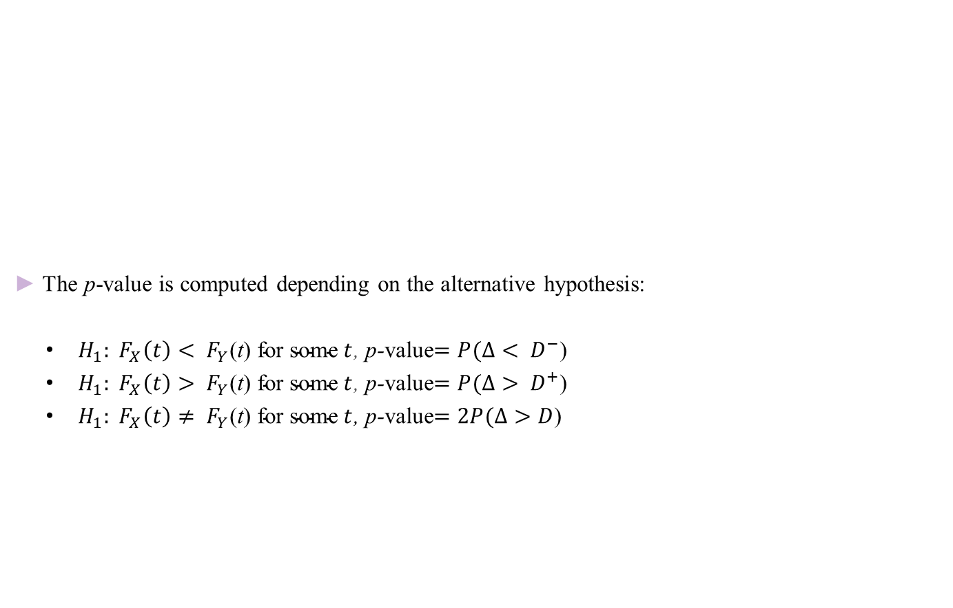
Kolmogorov-Smirnov Test
03
► The p-value is computed depending on the alternative hypothesis:
$H_{1}: F_{X}\left(t\right)< F_{Y}\text{(}\text{t}\text{) }\text{for} \text{some} t$, p-value$=P(Δ< D^{−}$)
$H_{1}: F_{X}\left(t\right)> F_{Y}\text{(}\text{t}\text{) }\text{for} \text{some} t$, p-value$=P(Δ> D^{+}$)
$H_{1}: F_{X}\left(t\right)≠ F_{Y}\text{(}\text{t}\text{) }\text{for} \text{some} t$, p-value$=2P(Δ>D$)
17

Slide 18
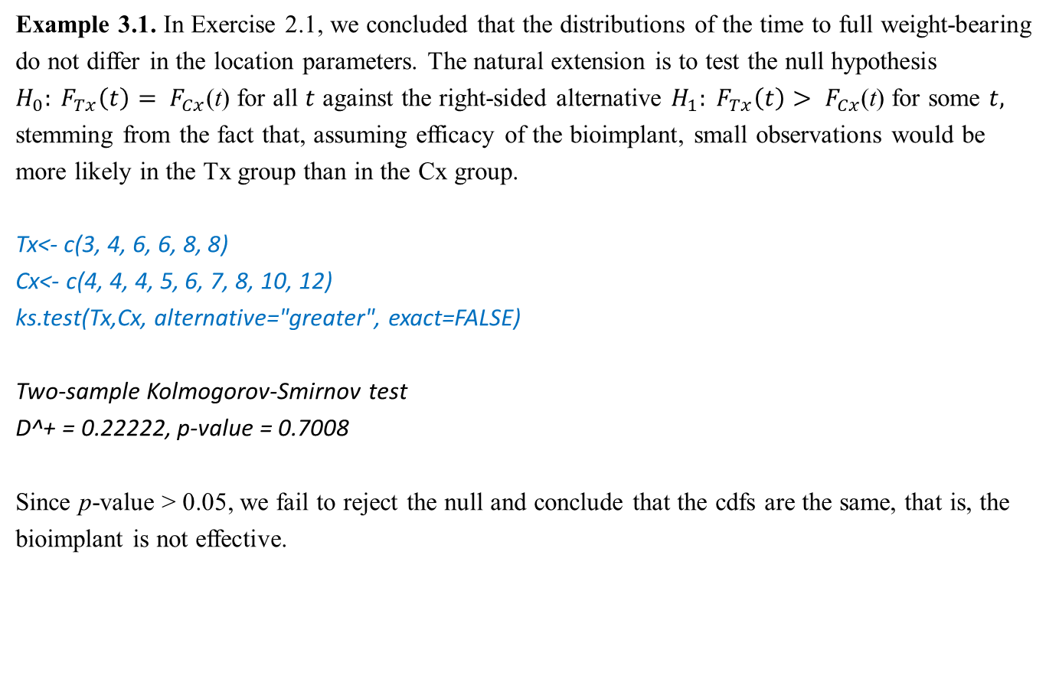
Example of Kolmogorov-Smirnov Test
03
Example 3.1. In Exercise 2.1, we concluded that the distributions of the time to full weight-bearing
do not differ in the location parameters. The natural extension is to test the null hypothesis
$H_{0}: F_{Tx}\left(t\right)= F_{Cx}$(t) for all $t$ against the right-sided alternative $H_{1}: F_{Tx}\left(t\right)> F_{Cx}$(t) for some $t,$
stemming from the fact that, assuming efficacy of the bioimplant, small observations would be
more likely in the Tx group than in the Cx group.
Tx<- c(3, 4, 6, 6, 8, 8)
Cx<- c(4, 4, 4, 5, 6, 7, 8, 10, 12)
ks.test(Tx,Cx, alternative="greater", exact=FALSE)
Two-sample Kolmogorov-Smirnov test
D^+ = 0.22222, p-value = 0.7008
Since p-value > 0.05, we fail to reject the null and conclude that the cdfs are the same, that is, the
bioimplant is not effective.
18

Slide 19
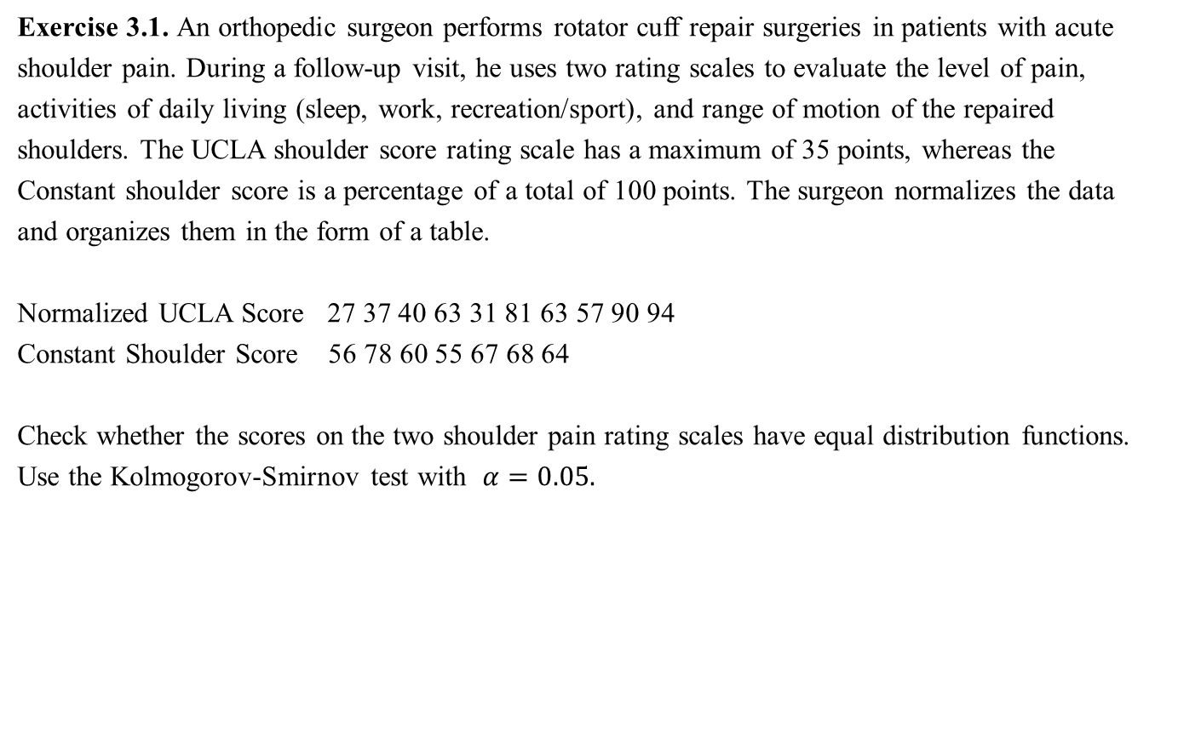
Exercise for Kolmogorov-Smirnov Test
03
Exercise 3.1. An orthopedic surgeon performs rotator cuff repair surgeries in patients with acute
shoulder pain. During a follow-up visit, he uses two rating scales to evaluate the level of pain,
activities of daily living (sleep, work, recreation/sport), and range of motion of the repaired
shoulders. The UCLA shoulder score rating scale has a maximum of 35 points, whereas the
Constant shoulder score is a percentage of a total of 100 points. The surgeon normalizes the data
and organizes them in the form of a table.
Normalized UCLA Score 27 37 40 63 31 81 63 57 90 94
Constant Shoulder Score 56 78 60 55 67 68 64
Check whether the scores on the two shoulder pain rating scales have equal distribution functions.
Use the Kolmogorov-Smirnov test with $α=0.05.$
19

Slide 20
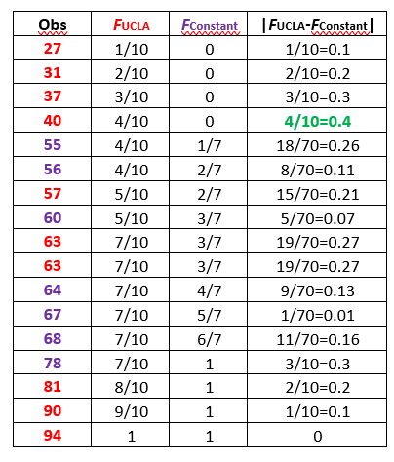
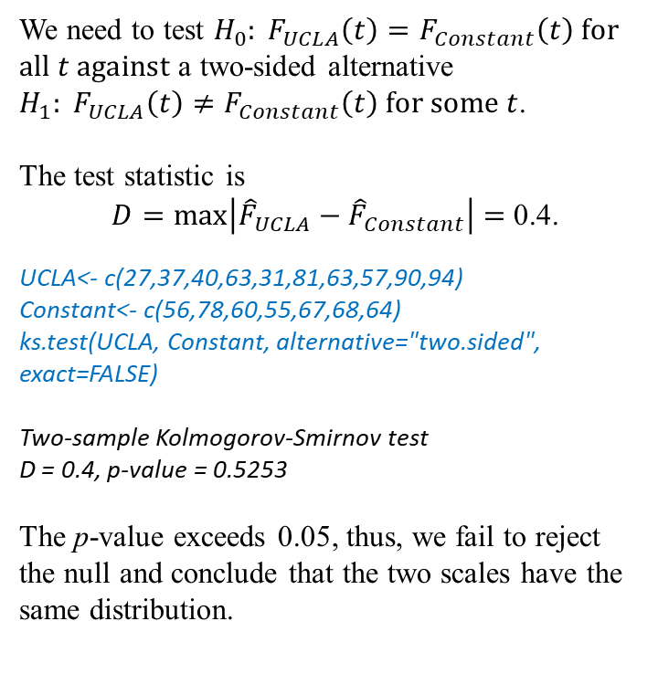
Exercise for Kolmogorov-Smirnov Test
03
Solution: We compute the values of the empirical cdfs.
We need to test $H_{0}: F_{UCLA}\left(t\right)=F_{Constant}\left(t\right) for all t against$ a two-sided alternative $H_{1}: F_{UCLA}\left(t\right)≠F_{Constant}\left(t\right) for some t$.
The test statistic is
$D=\max\left|{\hat{F}}_{UCLA}−{\hat{F}}_{Constant}\right|=$ 0.4.
UCLA<- c(27,37,40,63,31,81,63,57,90,94)
Constant<- c(56,78,60,55,67,68,64)
ks.test(UCLA, Constant, alternative="two.sided",
exact=FALSE)
Two-sample Kolmogorov-Smirnov test
D = 0.4, p-value = 0.5253
The p-value exceeds 0.05, thus, we fail to reject
the null and conclude that the two scales have the
same distribution.
20

Slide 21
Kruskal-Wallis H-test
04
21

Slide 22
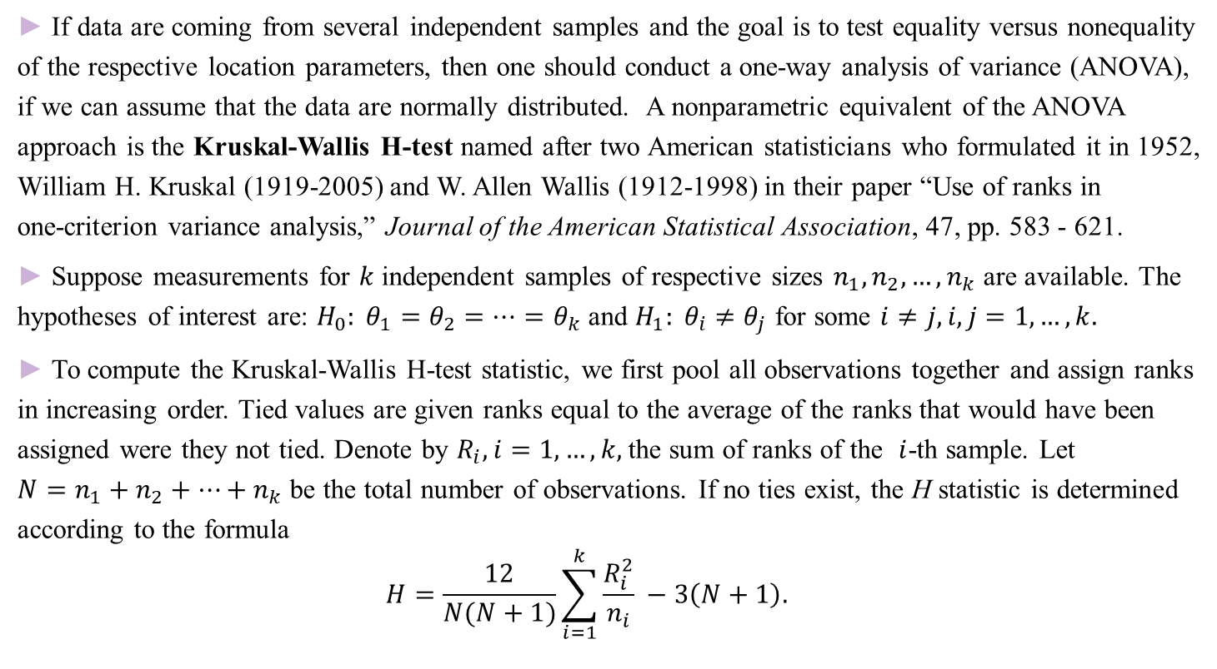
Kruskal-Wallis H-test
04
► If data are coming from several independent samples and the goal is to test equality versus nonequality
of the respective location parameters, then one should conduct a one-way analysis of variance (ANOVA),
if we can assume that the data are normally distributed. A nonparametric equivalent of the ANOVA
approach is the Kruskal-Wallis H-test named after two American statisticians who formulated it in 1952,
William H. Kruskal (1919-2005) and W. Allen Wallis (1912-1998) in their paper “Use of ranks in
one-criterion variance analysis,” Journal of the American Statistical Association, 47, pp. 583 - 621.
► Suppose measurements for $k$ independent samples of respective sizes $n_{1}, n_{2},…, n_{k}$ are available. The
hypotheses of interest are: $H_{0}: θ_{1}=θ_{2}=…=θ_{k}$ and $H_{1}: θ_{i}≠θ_{j}$ for some $i≠j, i,j=1,…, k.$
► To compute the Kruskal-Wallis H-test statistic, we first pool all observations together and assign ranks
in increasing order. Tied values are given ranks equal to the average of the ranks that would have been
assigned were they not tied. Denote by $R_{i}, i=1,…, k,$the sum of ranks of the $i$-th sample. Let
$N=n_{1}+n_{2}+…+n_{k}$ be the total number of observations. If no ties exist, the H statistic is determined
according to the formula
$$H=\frac{12}{N(N+1)}\sum_{i=1}^{k}{\frac{R_{i}^{2}}{n_{i}}} −3\left(N+1\right).$$
22

Slide 23
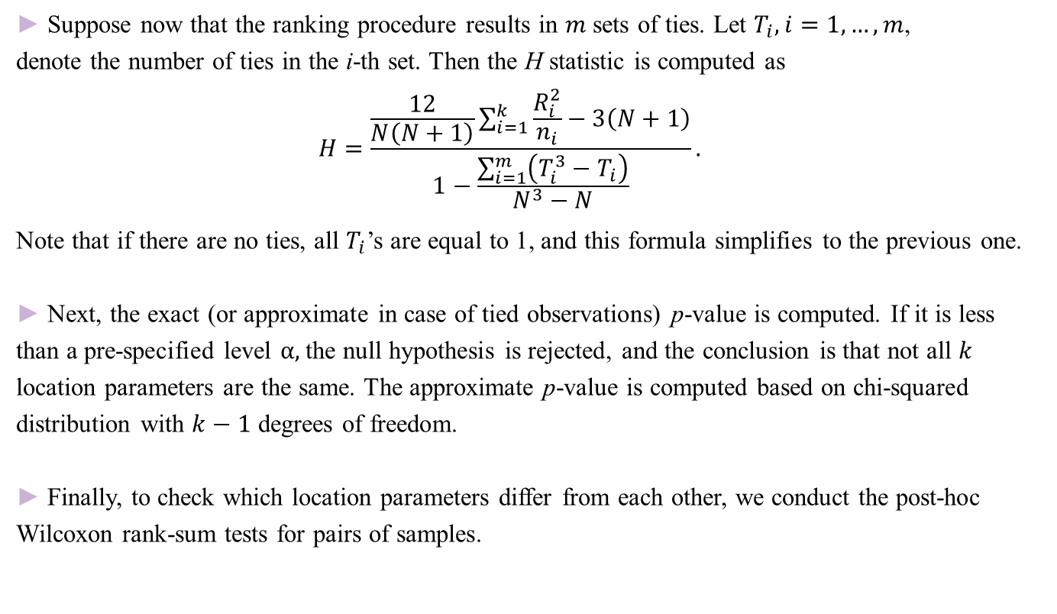
Kruskal-Wallis H-test
04
► Suppose now that the ranking procedure results in $m$ sets of ties. Let $T_{i}, i=1,…, m$,
denote the number of ties in the i-th set. Then the H statistic is computed as
$$H=\frac{\frac{12}{N\left(N+1\right)}\sum_{i=1}^{k}{\frac{R_{i}^{2}}{n_{i}}}−3\left(N+1\right)}{1−\frac{\sum_{i=1}^{m}{\left(T_{i}^{3}−T_{i}\right)}}{N^{3}−N}}.$$
Note that if there are no ties, all $T_{i}$’s are equal to 1, and this formula simplifies to the previous one.
► Next, the exact (or approximate in case of tied observations) p-value is computed. If it is less
than a pre-specified level $α,$the null hypothesis is rejected, and the conclusion is that not all $k$
location parameters are the same. The approximate p-value is computed based on chi-squared
distribution with $k−1$ degrees of freedom.
► Finally, to check which location parameters differ from each other, we conduct the post-hoc
Wilcoxon rank-sum tests for pairs of samples.
23

Slide 24
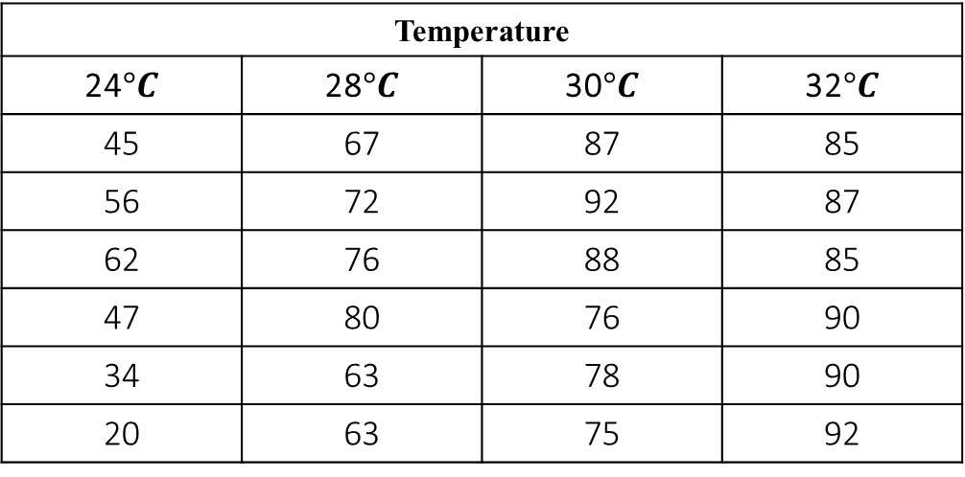
Example of Kruskal-Wallis H-test
04
Example. 4.1. A botanist studies the germination of seeds of a certain plant under four different
temperatures. She plants the seeds in her laboratory and records the germination rates (percent that
germinated in a batch of 100). The table below displays the data.
Temperature
24$°C$ | 28$°C$ | 30$°C$ | 32$°C$
45 | 67 | 87 | 85
56 | 72 | 92 | 87
62 | 76 | 88 | 85
47 | 80 | 76 | 90
34 | 63 | 78 | 90
20 | 63 | 75 | 92
24

Slide 25
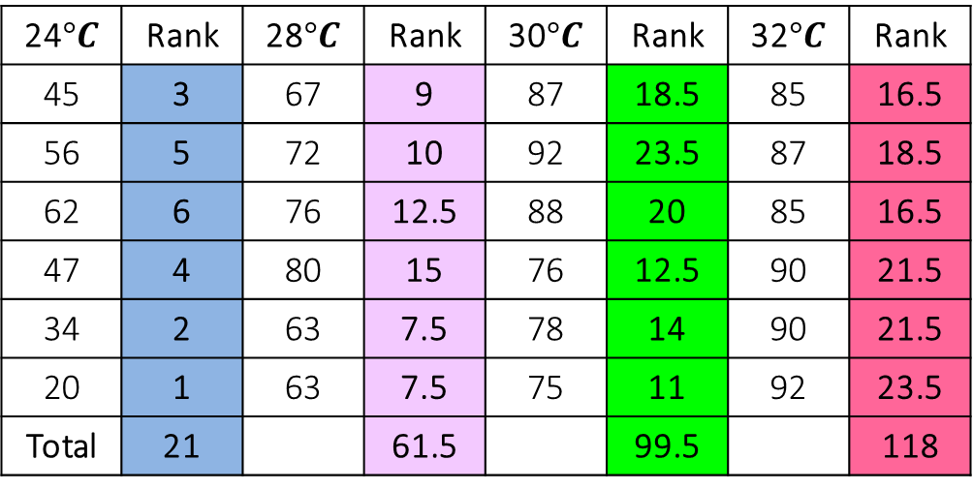
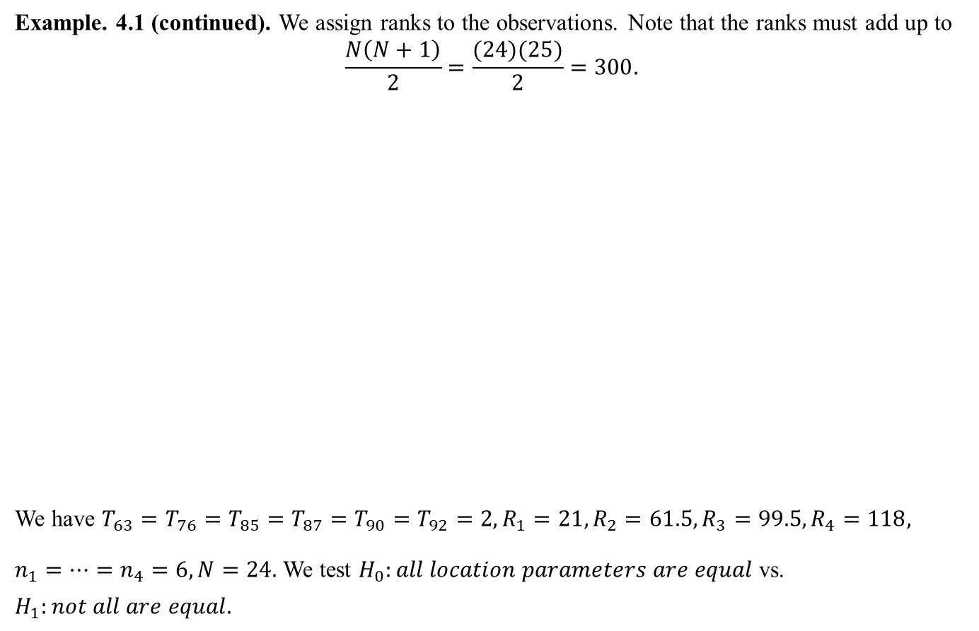
Example of Kruskal-Wallis H-test
04
Example. 4.1 (continued). We assign ranks to the observations. Note that the ranks must add up to
$$\frac{N\left(N+1\right)}{2}=\frac{(24)(25)}{2}=300.$$
We have $T_{63}=T_{76}=T_{85}=T_{87}=T_{90}=T_{92}=2, R_{1}=21, R_{2}=61.5, R_{3}=99.5, R_{4}=118,$
$n_{1}=…=n_{4}=6, N=24.$ We test $H_{0}:all location parameters are equal$ vs.
$$H_{1}:not all are equal.$$
24$°C$ | Rank | 28$°C$ | Rank | 30$°C$ | Rank | 32$°C$ | Rank
45 | 3 | 67 | 9 | 87 | 18.5 | 85 | 16.5
56 | 5 | 72 | 10 | 92 | 23.5 | 87 | 18.5
62 | 6 | 76 | 12.5 | 88 | 20 | 85 | 16.5
47 | 4 | 80 | 15 | 76 | 12.5 | 90 | 21.5
34 | 2 | 63 | 7.5 | 78 | 14 | 90 | 21.5
20 | 1 | 63 | 7.5 | 75 | 11 | 92 | 23.5
Total | 21 |  | 61.5 |  | 99.5 |  | 118
25

Slide 26
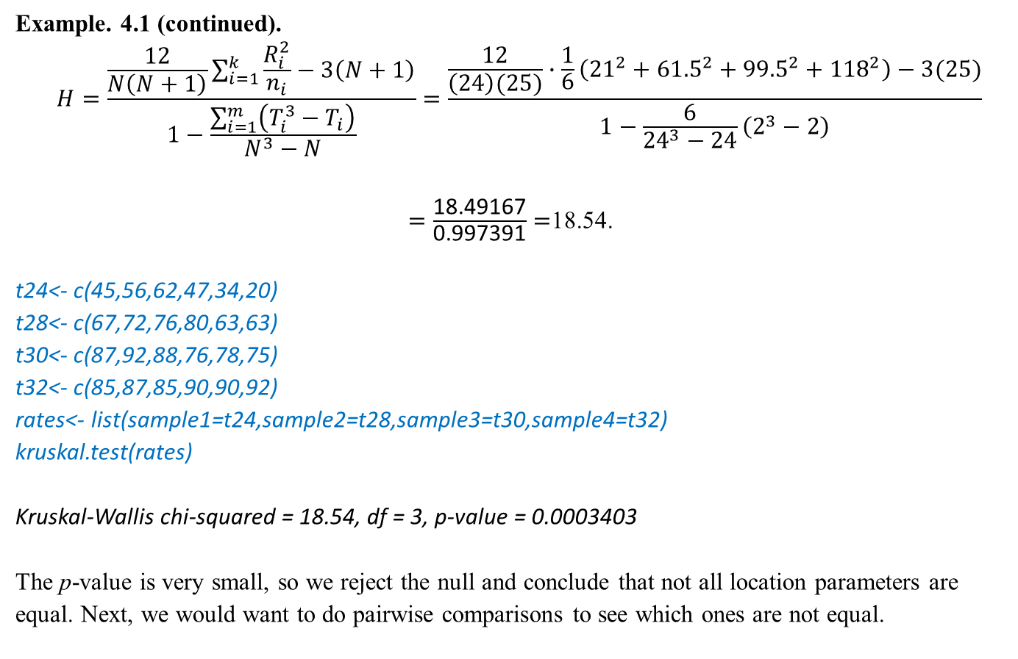
Example of Kruskal-Wallis H-test
04
Example. 4.1 (continued).
$$H=\frac{\frac{12}{N\left(N+1\right)}\sum_{i=1}^{k}{\frac{R_{i}^{2}}{n_{i}}}−3\left(N+1\right)}{1−\frac{\sum_{i=1}^{m}{\left(T_{i}^{3}−T_{i}\right)}}{N^{3}−N}}=\frac{\frac{12}{\left(24\right)(25)}∙\frac{1}{6}\left({21}^{2}+{61.5}^{2}+{99.5}^{2}+{118}^{2}\right)−3(25)}{1−\frac{6}{{24}^{3}−24}\left(2^{3}−2\right)}$$
$=\frac{\text{18.49167}}{\text{0.997391}}=$18.54.
t24<- c(45,56,62,47,34,20)
t28<- c(67,72,76,80,63,63)
t30<- c(87,92,88,76,78,75)
t32<- c(85,87,85,90,90,92)
rates<- list(sample1=t24,sample2=t28,sample3=t30,sample4=t32)
kruskal.test(rates)
Kruskal-Wallis chi-squared = 18.54, df = 3, p-value = 0.0003403
The p-value is very small, so we reject the null and conclude that not all location parameters are
equal. Next, we would want to do pairwise comparisons to see which ones are not equal.
26

Slide 27
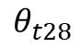
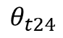
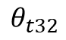
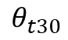
Example of Kruskal-Wallis H-test
04
Example. 4.1 (continued). We conduct the Wilcoxon rank-sum tests for pairs of samples.
wilcox.exact(t24,t28,alternative=“two.sided",exact=FALSE)
p-value = 0.003885
wilcox.exact(t24,t30,alternative=“two.sided",exact=FALSE)
p-value = 0.003948
wilcox.exact(t24,t32,alternative=“two.sided",exact=FALSE)
p-value = 0.003823
wilcox.exact(t28,t30,alternative=“two.sided",exact=FALSE)
p-value = 0.03006
wilcox.exact(t28,t32,alternative=“two.sided",exact=FALSE)
p-value = 0.003761
wilcox.exact(t30,t32,alternative=“two.sided",exact=FALSE)
p-value = 0.259
The location parameter for t24 is not
equal to the others, t28 and t30 are not
statistically distinguishable, t30 and t32 are not statistically distinguishable
either, but t28 and t32 are statistically
different.
$$θ_{t24}$$
$$θ_{t28}$$
$$θ_{t30}$$
$$θ_{t32}$$
27

Slide 28
Exercise for Kruskal-Wallis H-test
04
Exercise 4.1. Ecologists perform a study to compare lead contents in three fish ponds chosen at
random nationwide. The fish ponds are tested at six different locations and the lead contents (in ppb
– parts of lead per billion parts of water) are recorded. One measurement was invalid. The data are:
Perform the Kruskal-Wallis H-test at the 5% significance level. If needed, conduct the Wilcoxon
rank-sum tests to identify which fish ponds are different in lead contents.
Fish Pond | Lead Contents (in ppb)
A | 3 | 4 | 4 | 5 | 7 | 8
B | 10 | 11 | 11 | 12 | 18
C | 4 | 5 | 6 | 6 | 9 | 10
28

Slide 29
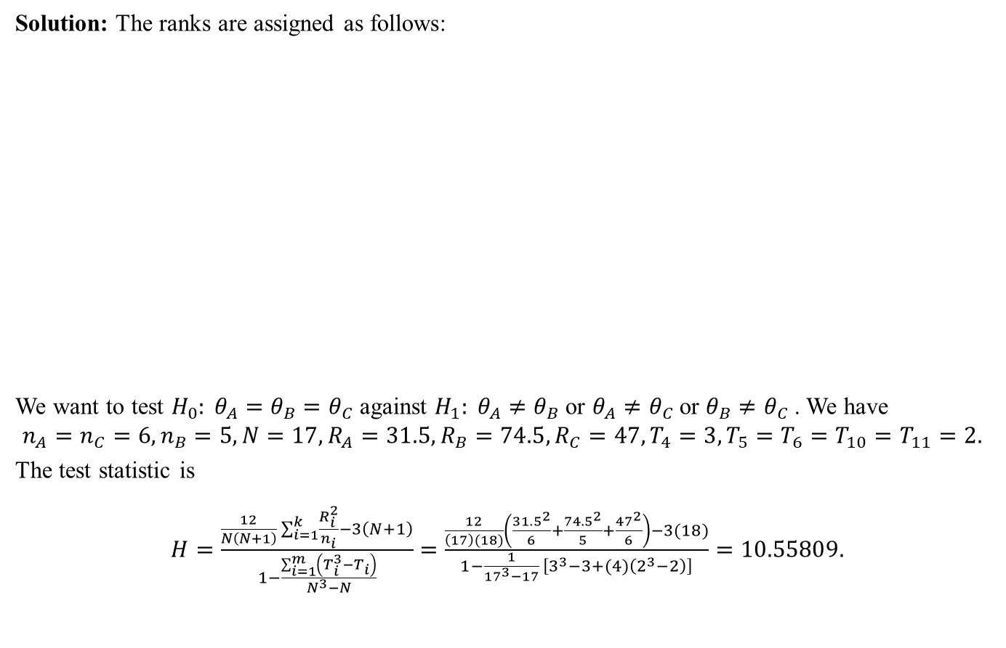
Exercise for Kruskal-Wallis H-test
04
Solution: The ranks are assigned as follows:
We want to test $H_{0}: θ_{A}=θ_{B}=θ_{C}$ against $H_{1}: θ_{A}≠θ_{B}$ or $θ_{A}≠θ_{C}$ or $θ_{B}≠θ_{C}$ . We have
$$n_{A}=n_{C}=6, n_{B}=5, N=17, R_{A}=31.5, R_{B}=74.5, R_{C}=47, T_{4}=3, T_{5}=T_{6}=T_{10}=T_{11}=2.$$
The test statistic is
$H=\frac{\frac{12}{N\left(N+1\right)}\sum_{i=1}^{k}{\frac{R_{i}^{2}}{n_{i}}}−3\left(N+1\right)}{1−\frac{\sum_{i=1}^{m}{\left(T_{i}^{3}−T_{i}\right)}}{N^{3}−N}}=\frac{\frac{12}{\left(17\right)(18)}\left(\frac{{31.5}^{2}}{6}+\frac{{74.5}^{2}}{5}+\frac{{47}^{2}}{6}\right)−3(18)}{1−\frac{1}{{17}^{3}−17} \left[3^{3}−3+(4)\left(2^{3}−2\right)\right]}=10.55809.$
Fish Pond | Lead Contents (in ppb)
A | 3 | 4 | 4 | 5 | 7 | 8 | Total
Rank | 1 | 3 | 3 | 5.5 | 9 | 10 | 31.5
B | 10 | 11 | 11 | 12 | 18
Rank | 12.5 | 14.5 | 14.5 | 16 | 17 |  | 74.5
C | 4 | 5 | 6 | 6 | 9 | 10
Rank | 3 | 5.5 | 7.5 | 7.5 | 11 | 12.5 | 47
29

Slide 30
Exercise for Kruskal-Wallis H-test
04
Solution (continued):
A<- c(3,4,4,5,7,8)
B<- c(10,11,11,12,18)
C<- c(4,5,6,6,9,10)
ppb<- list(sample1=A,sample2=B,sample3=C)
kruskal.test(ppb)
Kruskal-Wallis chi-squared = 10.558, df = 2, p-value = 0.005097
The p-value is very small, therefore we reject the null and conclude that not all location parameters
are the same. Next, we conduct the Wilcoxon rank-sum tests to see which ones are not equal.
30

Slide 31
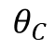
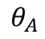
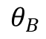
Exercise for Kruskal-Wallis H-test
04
Solution (continued):
wilcox.exact(A,B,alternative="two.sided",exact=FALSE)
p-value = 0.005939
wilcox.exact(A,C,alternative="two.sided",exact=FALSE)
p-value = 0.2248
wilcox.exact(B,C,alternative="two.sided",exact=FALSE)
p-value = 0.007686
The location parameters for A and C are the same whereas the one for B is not equal to either of the
other two.
$$θ_{A}$$
$$θ_{C}$$
$$θ_{B}$$
31

Slide 32
Spearman Rank Correlation Coefficient
05
32

Slide 33
Spearman Rank Correlation Coefficient
05
► A categorical variable assumes values in some categories. The variable is said to be ordinal or
measured on an ordinal scale if the categories have natural ordering. For example, size (XS, S, M,
L, XL), health (poor, fair, good, excellent), grades (A, B, C, D, F), education (less than high school,
high school graduate, above high school).
► A categorical variable is said to be nominal or measured on a nominal scale if there is no natural
ordering to the categories (they can be treated as names). For instance, opinion (yes, no, don’t know),
political affiliation (democrat, republican, independent, other), religious affiliation (protestant,
catholic, orthodox, other), race (African-American, Latino, Caucasian, Asian, Pacific Islander, other).
► Here we introduce point estimation and nonparametric test for correlation between two ordinal
variables, and for association between two nominal variables (or one nominal and one ordinal). The
test for correlation may also be carried out when one or both variables are continuous but
non-normally distributed.
33

Slide 34
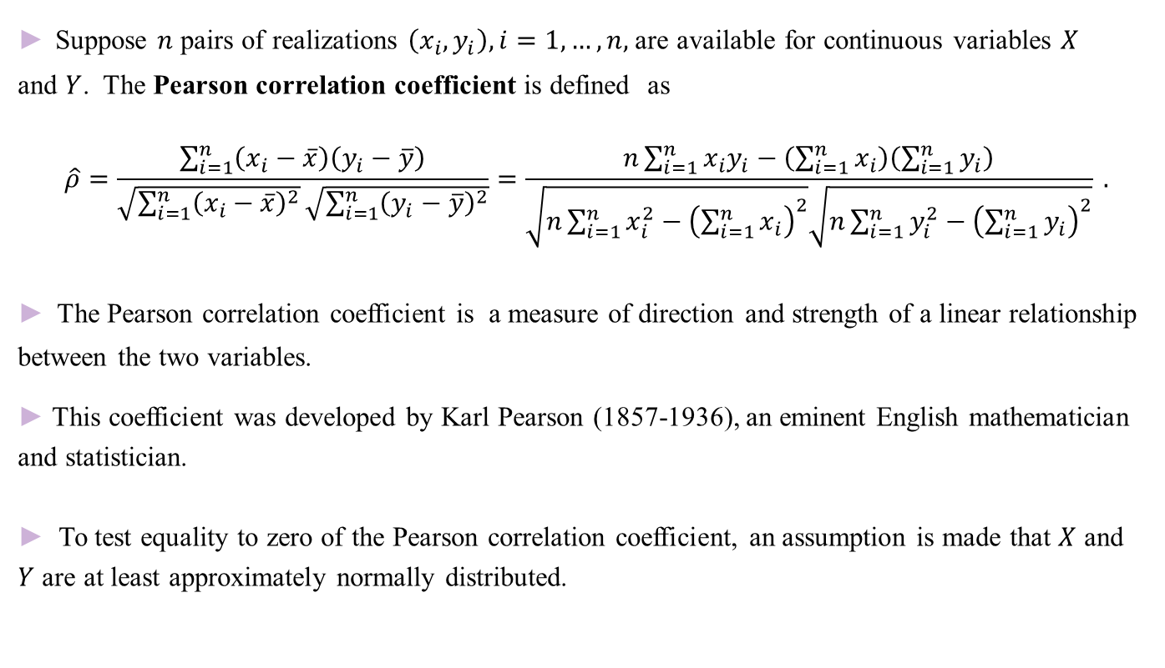
Spearman Rank Correlation Coefficient
05
► Suppose $n$ pairs of realizations $\left(x_{i}, y_{i}\right), i=1, …, n,$are available for continuous variables $X$
and $Y$. The Pearson correlation coefficient is defined as
$$\hat{ρ}=\frac{\sum_{i=1}^{n}{\left(x_{i}−\overline{x}\right)\left(y_{i}−\overline{y}\right)}}{\sqrt{\sum_{i=1}^{n}{{\left(x_{i}−\overline{x}\right)}^{2}}}\sqrt{\sum_{i=1}^{n}{{\left(y_{i}−\overline{y}\right)}^{2}}}}=\frac{n\sum_{i=1}^{n}{x_{i}y_{i}}−\left(\sum_{i=1}^{n}{x_{i}}\right)\left(\sum_{i=1}^{n}{y_{i}}\right)}{\sqrt{n\sum_{i=1}^{n}{x_{i}^{2}}−{\left(\sum_{i=1}^{n}{x_{i}}\right)}^{2}}\sqrt{n\sum_{i=1}^{n}{y_{i}^{2}}−{\left(\sum_{i=1}^{n}{y_{i}}\right)}^{2}}} .$$
► The Pearson correlation coefficient is a measure of direction and strength of a linear relationship
between the two variables.
► This coefficient was developed by Karl Pearson (1857-1936), an eminent English mathematician
and statistician.
► To test equality to zero of the Pearson correlation coefficient, an assumption is made that $X$ and
$Y$ are at least approximately normally distributed.
34

Slide 35
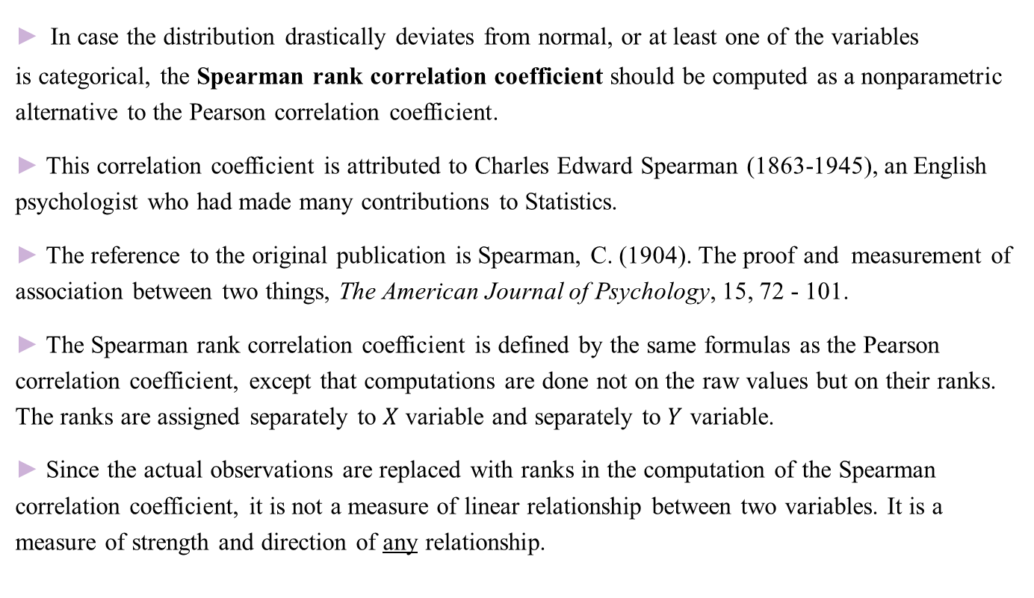
Spearman Rank Correlation Coefficient
05
► In case the distribution drastically deviates from normal, or at least one of the variables
is categorical, the Spearman rank correlation coefficient should be computed as a nonparametric
alternative to the Pearson correlation coefficient.
► This correlation coefficient is attributed to Charles Edward Spearman (1863-1945), an English
psychologist who had made many contributions to Statistics.
► The reference to the original publication is Spearman, C. (1904). The proof and measurement of
association between two things, The American Journal of Psychology, 15, 72 - 101.
► The Spearman rank correlation coefficient is defined by the same formulas as the Pearson
correlation coefficient, except that computations are done not on the raw values but on their ranks.
The ranks are assigned separately to $X$ variable and separately to $Y$ variable.
► Since the actual observations are replaced with ranks in the computation of the Spearman
correlation coefficient, it is not a measure of linear relationship between two variables. It is a
measure of strength and direction of any relationship.
35

Slide 36
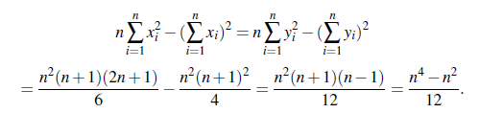
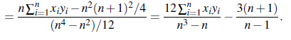
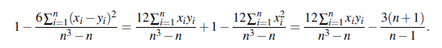
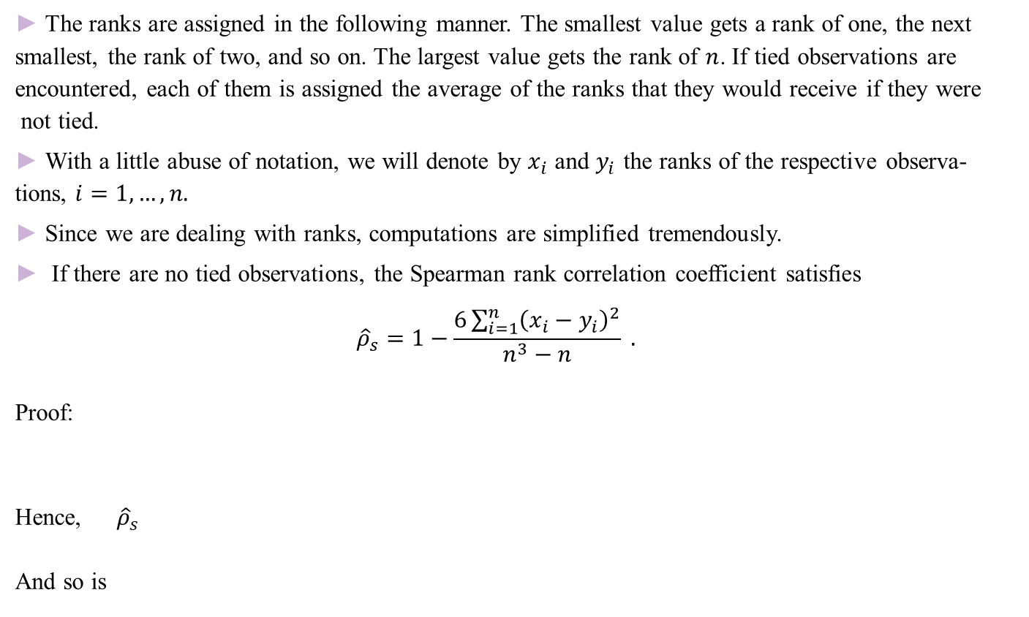
Spearman Rank Correlation Coefficient
05
► The ranks are assigned in the following manner. The smallest value gets a rank of one, the next
smallest, the rank of two, and so on. The largest value gets the rank of $n$. If tied observations are
encountered, each of them is assigned the average of the ranks that they would receive if they were
not tied.
► With a little abuse of notation, we will denote by $x_{i}$ and $y_{i}$ the ranks of the respective observa-
tions, $i=1,…, n.$
► Since we are dealing with ranks, computations are simplified tremendously.
► If there are no tied observations, the Spearman rank correlation coefficient satisfies
$${\hat{ρ}}_{s}=1−\frac{6\sum_{i=1}^{n}{{\left(x_{i}−y_{i}\right)}^{2}}}{n^{3}−n} .$$
Proof:
Hence, ${\hat{ρ}}_{s}$
And so is
36

Slide 37
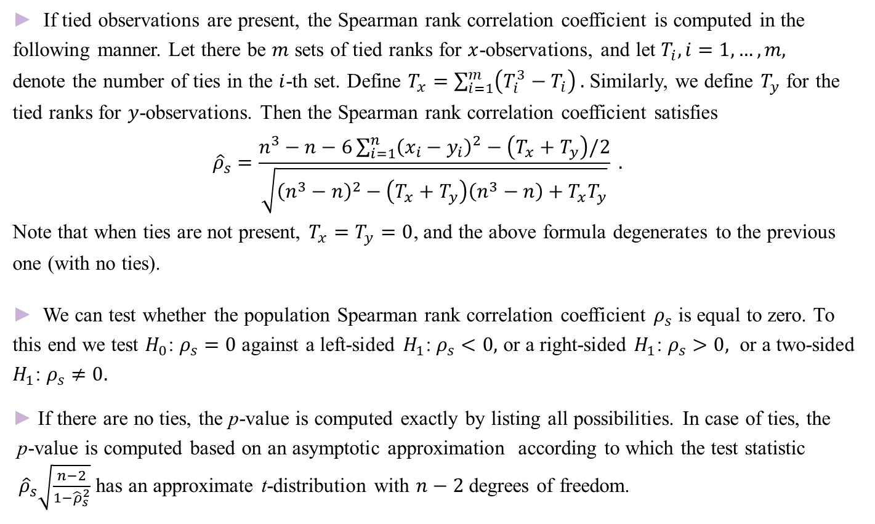
Spearman Rank Correlation Coefficient
05
► If tied observations are present, the Spearman rank correlation coefficient is computed in the
following manner. Let there be $m$ sets of tied ranks for $x$-observations, and let $T_{i}, i=1,…,m,$
denote the number of ties in the $i$-th set. Define $T_{x}=\sum_{i=1}^{m}{\left(T_{i}^{3}−T_{i}\right)}.$ Similarly, we define $T_{y}$ for the
tied ranks for $y$-observations. Then the Spearman rank correlation coefficient satisfies
$${\hat{ρ}}_{s}=\frac{n^{3}−n−6\sum_{i=1}^{n}{{\left(x_{i}−y_{i}\right)}^{2}−\left(T_{x}+T_{y}\right)/2}}{\sqrt{{\left(n^{3}−n\right)}^{2}−\left(T_{x}+T_{y}\right)\left(n^{3}−n\right)+T_{x}T_{y}}} .$$
Note that when ties are not present, $T_{x}=T_{y}=0$, and the above formula degenerates to the previous
one (with no ties).
► We can test whether the population Spearman rank correlation coefficient $ρ_{s}$ is equal to zero. To
this end we test $H_{0}$: $ρ_{s}=0$ against a left-sided $H_{1}$: $ρ_{s}<0,$ or a right-sided $H_{1}$: $ρ_{s}>0,$ or a two-sided
$H_{1}$: $ρ_{s}≠0.$
► If there are no ties, the p-value is computed exactly by listing all possibilities. In case of ties, the
p-value is computed based on an asymptotic approximation according to which the test statistic${\hat{ρ}}_{s}\sqrt{\frac{n−2}{1−{\hat{ρ}}_{s}^{2}}}$ has an approximate t-distribution with $n−2$ degrees of freedom.
37

Slide 38

Example of Spearman Rank Correlation Coefficient
05
Example 5.1. The reduction in intraocular pressure in treated (Tx) and control (Cx) eyes was
measured for nine glaucoma patients. The ophthalmologist predicts that there is a positive
correlation between the measurements. To verify the claim, we compute the Spearman rank
correlation coefficient and test whether it is significantly larger than zero.
Tx<- c(0.45, 1.95, 1.20, 0.65, 0.98, -1.98, 1.80, -0.76, 0.56)
Cx<- c(0.38, 0.90, 0.70, -0.50, 0.47, -1.30, 1.34, 0.13, -0.40)
cor.test(Tx, Cx, method="spearman“, alternative=“greater”)
Spearman's rank correlation rho
p-value = 0.004134
alternative hypothesis: true rho is greater than 0
sample estimates:
rho
0.8333333
Since the p-value < 0.05, we accept the alternative $H_{1}$: $ρ_{s}>0,$and conclude that there is a
positive correlation between the measurements.
38

Slide 39

Example of Spearman Rank Correlation Coefficient
05
Example 5.1 (continued). Here we show how to compute the correlation coefficient by hand.
Tx obs 0.45 1.95 1.20 0.65 0.98 -1.98 1.80 -0.76 0.56
Tx rank 3 9 7 5 6 1 8 2 4
Cx obs 0.38 0.90 0.70 -0.50 0.47 -1.30 1.34 0.13 -0.40
Cx rank 5 8 7 2 6 1 9 4 3
$$\sum_{i=1}^{n}{{\left(x_{i}−y_{i}\right)}^{2}}={(3−5)}^{2}+{(9−8)}^{2}+{(7−7)}^{2}+{(5−2)}^{2}+{(6−6)}^{2}$$
$$+{(1−1)}^{2}+{(8−9)}^{2}+{(2−4)}^{2}+{(4−3)}^{2}=4+1+9+1+4+1=20.$$
$${\hat{ρ}}_{s}=1−\frac{6\sum_{i=1}^{n}{{\left(x_{i}−y_{i}\right)}^{2}}}{n^{3}−n}=1−\frac{6\left(20\right)}{9^{3}−9}=0.83333.$$
39

Slide 40


Example of Spearman Rank Correlation Coefficient
05
Example 5.2. Researchers in health sciences conjecture that there is a negative association between
cigarette smoking and health. They survey ten adults and record the number of years that the
respondents smoked cigarettes regularly and their general health condition (poor (1), fair (2),
good (3), or excellent (4)). The data are:
years<- c(12, 33, 5, 3, 12, 6, 3, 0, 2, 46)
health<- c(1, 2, 3, 3, 2, 2, 4, 4, 3, 1)
Here we would need to compute the sample Spearman rank correlation coefficient ${\hat{ρ}}_{s}$and test
$H_{0}$: $ρ_{s}=0$ against a left-sided $H_{1}$: $ρ_{s}<0 .$ The data contain tied observations. R gives a warning
“Cannot compute exact p-value with ties.” Therefore, we need to lift the requirement of the exact
test.
cor.test(years, health, method="spearman“, alternative=“less”, exact=FALSE)
Spearman's rank correlation rho
p-value = 0.0003818
alternative hypothesis: true rho is less than 0
sample estimates:
rho
-0.8807819
Since p-value<0.05, we accept $H_{1}$, and conclude that there is a negative association between
cigarette smoking and health.
40

Slide 41

Example of Spearman Rank Correlation Coefficient
05
Example 5.2 (continued). Next, we show how to calculate the correlation coefficient.
years obs 12 33 5 3 12 6 3 0 2 46
years rank 7.5 9 5 3.5 7.5 6 3.5 1 2 10
health obs 1 2 3 3 2 2 4 4 3 1
health ranks 1.5 4 7 7 4 4 9.5 9.5 7 1.5
For years, there are two sets of ties of size 2 each(two 3’s and two 12’s). Thus, $T_{1}=T_{2}=2$ and
$T_{x}=\sum_{i=1}^{m}{\left(T_{i}^{3}−T_{i}\right)=\left(2^{3}−2\right)+\left(2^{3}−2\right)=12}.$ For health, there are four sets of ties (two 1’s
and 4’s and three 2’s and 3’s). Hence, $T_{1}=T_{2}=2,$ $T_{3}=T_{4}=3,$ and $T_{y}=\left(2\right)\left(2^{3}−2\right)$
$+(2)\left(3^{3}−3\right)=60.$ The sample size is $n=10, \sum_{i=1}^{n}{{\left(x_{i}−y_{i}\right)}^{2}=299,}$and the estimated Spearman rank
correlation coefficient is
$${\hat{ρ}}_{s}=\frac{n^{3}−n−6\sum_{i=1}^{n}{{\left(x_{i}−y_{i}\right)}^{2}−\left(T_{x}+T_{y}\right)/2}}{\sqrt{{\left(n^{3}−n\right)}^{2}−\left(T_{x}+T_{y}\right)\left(n^{3}−n\right)+T_{x}T_{y}}}=\frac{{10}^{3}−10−\left(6\right)\left(299\right)−(12+60)/2}{\sqrt{{\left({10}^{3}−10\right)}^{2}−\left(12+60\right)\left({10}^{3}−10\right)+(12)(60)}}$$
$$=−0.88078.$$
41

Slide 42
Exercise for Spearman Rank Correlation Coefficient
05
Exercise 5.1. A family therapist conjectures that there is a negative association between the highest
educational degree a husband attains and the severity of domestic violence. She surveys her next
15 clients and collects information on both variables. The education variable is broken into three
categories: (1) less than high school, (2) high school graduate or equivalent, and (3) some
college or higher. The severity of violence is measured at three levels: (1) never, (2) sometimes, and
(3) often. The data are given below. Note that R requires that data are entered as numeric.
educ<- c(2, 3, 2, 2, 3, 3, 3, 2, 1, 3, 1, 1, 2, 3, 1)
violence<- c(1, 3, 3, 2, 1, 1, 3, 3, 3, 1, 3, 1, 2, 2, 2)
Argue that computing the sample Spearman correlation coefficient would be the most appropriate in
this case. Conduct the test. State the hypotheses, calculate the test statistic, p-value, and draw
conclusion.
42

Slide 43

Exercise for Spearman Rank Correlation Coefficient
05
Solution: Both variables are categorical on an ordinal scale and thus Spearman correlation
coefficient is the most appropriate statistic in this case. We would like to test $H_{0}$: $ρ_{s}=0$ against a
left-sided $H_{1}$: $ρ_{s}<0$.
educ<- c(2, 3, 2, 2, 3, 3, 3, 2, 1, 3, 1, 1, 2, 3, 1)
violence<- c(1, 3, 3, 2, 1, 1, 3, 3, 3, 1, 3, 1, 2, 2, 2)
cor.test(educ, violence, method="spearman", alternative="less", exact=FALSE)
Spearman's rank correlation rho
p-value = 0.2284
alternative hypothesis: true rho is less than 0
sample estimates:
rho
-0.2080808
The test statistic is ${\hat{ρ}}_{s}=−0.2080808.$ It is negative but the p-value=0.2284 > 0.05 and we fail to
reject the null hypothesis. We conclude that there is no negative association between the educational
level and severity of domestic violence.
43

Slide 44

Exercise for Spearman Rank Correlation Coefficient
05
Solution (continued): Here we show the calculations for the correlation coefficient.
educ obs 2 3 2 2 3 3 3 2 1 3 1 1 2 3 1
educ rank 7 12.5 7 7 12.5 12.5 12.5 7 2.5 12.5 2.5 2.5 7 12.5 2.5
violence obs 1 3 3 2 1 1 3 3 3 1 3 1 2 2 2
violence rank 3 12.5 12.5 7.5 3 3 12.5 12.5 12.5 3 12.5 3 7.5 7.5 7.5
For educ, $T_{1}=4, T_{2}=5, T_{3}=6,$ and $T_{x}=\left(4^{3}−4\right)+\left(5^{3}−5\right)$+ $\left(6^{3}−6\right)=390.$
For violence, $T_{1}=5, T_{2}=4, T_{3}=6,$ and $T_{y}=\left(5^{3}−5\right)+\left(4^{3}−4\right)$+ $\left(6^{3}−6\right)=390.$
The sample size is $n=15, \sum_{i=1}^{n}{{\left(x_{i}−y_{i}\right)}^{2}=598,}$and the sample Spearman rank
correlation coefficient is
$${\hat{ρ}}_{s}=\frac{n^{3}−n−6\sum_{i=1}^{n}{{\left(x_{i}−y_{i}\right)}^{2}−\left(T_{x}+T_{y}\right)/2}}{\sqrt{{\left(n^{3}−n\right)}^{2}−\left(T_{x}+T_{y}\right)\left(n^{3}−n\right)+T_{x}T_{y}}}=\frac{{15}^{3}−15−\left(6\right)(598)−(390+390)/2}{\sqrt{{\left({15}^{3}−15\right)}^{2}−\left(390+390\right)\left({15}^{3}−15\right)+(390)(390)}}$$
$$=\frac{−618}{2970}=−0.20808.$$
44

Slide 45
The Fisher Exact Test
06
45

Slide 46

The Fisher Exact Test
06
► Consider two scenarios. In the first scenario, $r$ independent samples are drawn from different
populations and a single categorical variable with $c$ levels is observed for each individual. In the
second scenario, one sample is drawn from one population and two variables with $r$ and $c$levels,
respectively, are observed for each individual. In both cases, the data can be presented in
the form of an $r×c$ table of frequencies, called a two-way table or contingency table.
► For these two scenarios, the testing procedures are identical but statistical hypotheses differ.
For several samples and one variable, equality of proportions is tested, that is, the null hypothesis
is that the column proportions are equal across the rows (which represent samples), and the
alternative hypothesis is that column proportions are not all equal. For a single sample and two
variables, the null hypothesis is that there is no association between the measured variables (i.e.,
they are independent), whereas the alternative hypothesis states that an association exists (or that
the variables are not independent).
46

Slide 47






The Fisher Exact Test
06
Scenario 1
<$r$ independent samples and one
categorical variable with $c$ levels>
Scenario 2
< one sample and two categorical
variables with $r$ and $c$levels>
 | Variable Level
Sample | $$1$$ | $$2$$ | $$…$$ | $$c$$
$$1$$
$$2$$
$$…$$
$$r$$
 | Variable 2 Level
Variable 1 Level | $$1$$ | $$2$$ | $$…$$ | $$c$$
$$1$$
$$2$$
$$…$$
$$r$$
$$H_{0}:column proportions are equal across rows$$
vs.
$$H_{1}:not all column proportions are equal$$
Test for equality of proportions
$$H_{0}:the two variable are independent$$
vs.
$$H_{1}:the two variable are not independent$$
Test for independence
47

Slide 48

The Fisher Exact Test
06
► If observed frequencies in each cell of the contingency table are sufficiently high, a chi-square
test can be carried out in both situations. The assumption of validity of the chi-square test is that the
expected count under the null hypothesis for each cell is at least 5. The expected count in a cell is
defined as the product of the corresponding row and column totals divided by the grand total. If this
assumption is violated and some expected counts are below 5, a nonparametric Fisher exact test
may be used as a replacement.
► The Fisher exact test bears the name of Sir Ronald Aylmer Fisher (1890-1962), a famous English
statistician. He was the first who introduced this test for a $2×2$contingency table in his 1925 book
Statistical Methods for Research Workers. It was later extended to a general $r×c$ table in
Freeman, G.H. and Halton, J.H. (1951). Note on an Exact Treatment of Contingency, Goodness of
Fit and Other Problems of Significance, Biometrika, 38, 141 – 149.
48

Slide 49


The Fisher Exact Test
06
 | $$1$$ | $$2$$ | $$…$$ | $$c$$ | Row Total
$$1$$ | $$n_{11}(e_{11})$$ | $$n_{12}(e_{12})$$ | $$…$$ | $$n_{1c}(e_{1c})$$ | $$n_{1∙}$$
$$2$$ | $$n_{21}(e_{21})$$ | $$n_{22}(e_{22})$$ | $$…$$ | $$n_{2c}(e_{2c})$$ | $$n_{2∙}$$
$$…$$ | $$…$$ | $$…$$ | $$…$$ | $$…$$ | $$…$$
$$r$$ | $$n_{r1}(e_{r1})$$ | $$n_{r2}(e_{r2})$$ | $$…$$ | $$n_{rc}(e_{rc})$$ | $$n_{r∙}$$
Column Total | $$n_{∙1}$$ | $$n_{∙2}$$ | $$…$$ | $$n_{∙c}$$ | $$n_{∙∙}$$
Grand total
► $n_{ij}, i=1, …, r, j=1, …, c,$ are the observed counts.
► $e_{ij}=\frac{(row total)(column total)}{grand total}=\frac{{(n}_{i∙}{)(n}_{∙j})}{n_{∙∙}}, i=1, …, r, j=1, …, c,$
are the expected counts.
► Rule: if all expected values are 5 or larger, use the chi-squared test. If at least one
expected value is less than 5, use the Fisher exact test.
49

Slide 50

The Fisher Exact Test
06
► Calculations for the Fisher exact test in a general case are too complex to be done by
hand, and are carried out by software.
► The testing procedure is as follows. First, the totals are computed for each of the $r$rows
and $c$ columns. Second, all possible tables with the same totals are enumerated, and the
probability of observing each table is computed. Finally, the p-value for the Fisher exact
test is calculated as the sum of all probabilities that are less than or equal to the probability
of the actually observed table.
► If the p-value is larger than a pre-specified level $α$, the null hypothesis is not rejected.
Otherwise, the alternative is accepted.
► Next, we give an explanation of how to compute the probability of a table with fixed
row and column totals in the case of a $2×2$ table. For larger sized tables, analogous
formulas may be derived.
50

Slide 51


The Fisher Exact Test
06
► Consider a $2×2$ contingency table, and assume that the row and column totals and the
grand total are fixed.
51

Slide 52


The Fisher Exact Test
06
► As an example, suppose the following $2×2$ contingency table is observed:
The probability of this table is $\frac{(5!)(11!)(6!)(10!)}{(16!)(4!)(1!)(2!)(9!)}=0.0343.$
► Overall, there are 6 tables with the same row and column totals. They are listed on the
next slide, along with the associated probabilities.
52

Slide 53

The Fisher Exact Test
06
► The tables that have probabilities of 0.0343 or smaller are marked with an asterisk. The
p-value is the sum of these probabilities.
► The p-value for the Fisher exact test in this example is 0.0343+0.0014 = 0.0357.
53

Slide 54
Example of the Fisher Exact Test
06
Example 6.1 (Equality of proportions). A clinical trial was conducted with three groups taking
medication A, medication B, or placebo. The data are given as counts of the number of subjects
who experience a relief and those who didn’t. The data are:
clinical.trial<- matrix(c(8, 2, 6, 4, 2, 8), nrow = 2, dimnames = list(relief = c('yes', 'no'),
group=c('med. A', 'med. B', 'placebo’)))
To test the null hypothesis that the proportions experiencing a relief are the same in each group,
we conduct the Fisher exact test by running the following R script:
fisher.test(clinical.trial)
Fisher's Exact Test for Count Data
p-value = 0.03661
alternative hypothesis: two.sided
The p-value is smaller than 0.05, thus, we reject the null hypothesis and conclude that not all
proportions of subjects experiencing a relief are equal.
Relief | Group
 | Med. A | Med. B | Placebo
Yes | 8 | 6 | 2
No | 2 | 4 | 8
54

Slide 55

Example of the Fisher Exact Test
06
Example 6.2 (Independence). An administration of a college is interested in the increase of
utilization of a student gym. They randomly sample 15 students and record their level of daily
physical activity (high/moderate/low) and whether they exercise in the gym (yes/no). The data are:
actlevel <- c('high', 'moderate', 'low', 'low', 'low', 'low', 'low', 'moderate', 'moderate', 'high', 'low',
'moderate', 'moderate', 'high', 'moderate')
gym.used <- c('no', 'no', 'yes', 'yes', 'yes', 'yes', 'no', 'yes', 'yes', 'no', 'no', 'yes', 'yes', 'yes', 'yes')
To test the null hypothesis that there is no association between these two variables, we conduct
the Fisher exact test by running the following R script:
fitness.table<- table(actlevel, gym.used)
fisher.test(fitness.table)
Fisher's Exact Test for Count Data
p-value = 0.3357
The p-value is larger than 0.05, therefore, we fail to reject the null hypothesis and conclude that
there is no association between students’ fitness level and gym utilization.
55

Slide 56

Exercise for the Fisher Exact Test
06
Exercise 6.1. A pilot study of a new heart valve with a total of 90 patients is conducted at three
centers: in Stockholm, Washington, and Denver. Investigators suspect that patient populations in
these three centers differ with respect to age. The data are as follows:
Confirm or dissipate the investigators’ suspicion by conducting the Fisher exact test. Clearly state
the null and the alternative hypotheses and your conclusion.
56

Slide 57

Exercise for the Fisher Exact Test
06
Solution: We would like to test $H_{0}$: proportions in columns equal across rows vs. $H_{1}$: not all
proportions in columns are equal across rows. The run the code:
center<- c('Stockholm','Washington','Denver')
age<- c('20s30s','40s50s','60s','70splus')
data<- matrix(c(5, 10, 13, 12, 8, 11, 4, 3, 2, 14, 8, 0), nrow = 3, dimnames = list(center, age))
fisher.test(data)
The p-value is:
p-value = 0.00154
Since the p-value is small, we reject the null and confirm the suspicion of the investigators that the
three populations differ with respect to age.
57

Slide 58
Exercise for the Fisher Exact Test
06
Exercise 6.2. A library science specialist is wondering whether American fiction writers were more
likely to use pen names before the 20th century. She randomly selects 30 fiction writers, 12 of whom
wrote before the 20th century and 18, after the 20th century, and finds that 6 of the writers in
the first group used pen names, and 6 used their real names, whereas in the second group, 13
wrote under a pen name and 5 used real names. Formulate statistical hypotheses that reflect the
specialist’s interest. Conduct the Fisher exact test.
58

Slide 59

Exercise for the Fisher Exact Test
06
Solution: The hypotheses of interest are $H_{0}:pen name use and {book}^{′}s age are independent$and
$H_{1}:$they are not independent. The following script is submitted.
names<- c('pen', 'real', 'pen', 'pen', 'real', 'pen', 'pen', 'real', 'pen', 'pen', 'pen', 'pen',
'pen', 'pen', 'real', 'real', 'real', 'pen', 'pen', 'pen', 'pen', 'pen', 'real', 'pen', 'real',
'real', 'real', 'pen', 'real', 'pen')
time<- c('after', 'before', 'after', 'before', 'before', 'after', 'after', 'after', 'before',
'after', 'after', 'before', 'before', 'after', 'after', 'before', 'after', 'after', 'after',
'before', 'after', 'after', 'after', 'after', 'before', 'after', 'before', 'after', 'before',
'before')
books.table<- table(names, time)
fisher.test(books.table)
p-value = 0.2663
The p-value is larger than 0.05, hence we fail to reject the null, and conclude that American fiction
writers were not more likely to use pen names before the 20th century.
59

Slide 60
The Loess Regression
07
60

Slide 61



The Loess Regression
07
► Suppose the data contain the response variable $y$ and predictors $x_{1}, …, x_{k},$ and we would like to
fit a regression model. Sometimes the relationship is not linear, or polynomial, or exponential. If the
data exhibit periodicity (seasonal variations, like in the picture), then none of the traditional
response functions from parametric world would have
a satisfactory fit to these data.
► A useful tool in this case is a nonparametric
regression of the form $y=f\left(x_{1}, …, x_{k}\right)+$ $ε$ where
$f\left(∙\right)$is a nonparametric response function with no
explicit functional form, and $ε$’s are independent and
identically distributed random errors with a zero
mean and a constant variance. No assumption is
made on the form of the probability distribution of
$ε$’s.
► The loess regression method fits the response function $f\left(∙\right)$ and plots a curve (or surface in three
or higher dimensions) on the scatterplot.
61

Slide 62

The Loess Regression
07
► The loess (locally estimated scatterplot smoothing) method was introduced in Cleveland, W. S.
(1979). Robust Locally Weighted Regression and Smoothing Scatterplots, Journal of the American
Statistical Association, 74, 829 - 836.
► In a loess regression, the estimation of the response function at the data points is done by fitting a
polynomial regression function in the local neighborhood of each point. The radius of the neighbor-
hoods is determined by a pre-specified fraction of data points, called smoothing parameter, that
these neighborhoods encompass.
► A polynomial regression (typically linear or quadratic) is fit by the weighted least-squares
method with less weight given to points more distant from the center.
► Mathematically speaking, first the value of the smoothing parameter is specified as, say, $p/n$,
where $n$ is the total number of data points and $p$ is the number of points in each local neighborhood
$N_{p}(x^{0})$ of each point $x^{0}=\left(x_{1}^{0}, …, x_{k}^{0}\right).$
► Then a linear function is fitted through the $p$ points in the local neighborhood $N_{p}(x^{0})$. This linear
function is defined as $l(x)=l\left(x_{1}, …, x_{k}\right)=β_{0}+β_{1}\left(x_{1}−x_{1}^{0}\right)+…+β_{k}\left(x_{k}−x_{k}^{0}\right),$
for every point $x=\left(x_{1}, …, x_{k}\right)$ in $N_{p}(x^{0})$.
62

Slide 63

The Loess Regression
07
► The weighted least-squares predicted line $\hat{l}(x)={\hat{β}}_{0}+{\hat{β}}_{1}\left(x_{1}−x_{1}^{0}\right)+…+{\hat{β}}_{k}(x_{k}−x_{k}^{0})$
minimizes
$$\sum_{x_{i}∈N_{p}(x^{0})}{{\left[y_{i}−l(x_{i})\right]}^{2}w\left(\frac{\left\|x_{i}−x^{0}\right\|}{r(x^{0})}\right)}$$
where $x_{i}=\left(x_{1i},…, x_{ki}\right), i=1, …, p.$ Here $\left\|x_{i}−x^{0}\right\|$ denotes the Euclidean distance, that is,
ki
$$\left\|x_{i}−x^{0}\right\|=\sqrt{{(x_{1i}−x_{1}^{0})}^{2}+…+{(x_{ki}−x_{k}^{0})}^{2}},$$
$r\left(x^{0}\right)=\max_{x_{i}∈N_{p}(x^{0})}\left\|x_{i}−x^{0}\right\|$ is the radius of the neighborhood, and $w\left(∙\right)$ is the weight function.
► The response function $f\left(∙\right)$ is estimated at the point $x^{0}$ by the corresponding value of the
predicted line $\hat{l}\left(∙\right),$
$\hat{f}(x^{0})=$ $\hat{l}(x^{0})={\hat{β}}_{0}$.
Note that only the value of the fitted intercept comes into play.
63

Slide 64


The Loess Regression
07
►
► As a default weight function, R uses the tricube function
► The optimal smoothing parameter minimizes the bias-corrected Akaike information criterion
(AICC).
64

Slide 65

Example of Loess Regression
07
Example 7.1. Monthly unemployment rates for a county have been collected over one decade.
We plot the rates against months.
rate <- c(6.0, 6.7,4.9,4.4,5.8,4.8,5.5,6.7,4.7,5.6,6.5,6.0,4.7,5.1,7.2, 6.1,7.7,5.7,7.1,4.2,5.8,5.1,6.3,
5.1,3.9,4.7,4.4,5.9,4.1,5.8,4.9,5.4,3.9,6.0,4.1,4.6,5.7,5.0,4.5,6.9,5.6,4.6,4.4,4.1,3.2,6.3,4.2,4.7,4.3,
4.3,4.5,6.7,3.9,4.6,5.8,3.8,5.5,4.7,5.0,4.2,5.0,4.5,3.7,5.5,5.4,2.6,5.0,4.9,5.7,4.3,5.3,7.1,7.5,4.1,5.1,
5.7,4.8,6.1,6.3,4.1,5.7,7.2,6.0,7.2,8.0,8.7,8.5,9.1,7.5,10.5,8.5,7.4,10.5,8.9,8.5,9.9,8.3,9.9,7.2,9.5,
10.5,11.9,11.4,8.0,10.5,11.2,9.2,9.5,10.0,10.3,9.1,8.1,7.9,9.5,10.7,8.5,9.1,8.7,9.0,8.6)
month <- 1:120
plot(month, rate)
65

Slide 66

Example of Loess Regression
07
Example 7.1 (continued). Next, we fit a linear loess regression with the AICC-optimal
smoothing parameter.
library('fANCOVA')
rate.loess<- loess.as(month, rate, degree=1, criterion="aicc", plot=TRUE)
print(rate.loess$pars$span)
0.3290579
The curve looks too smooth.
It doesn’t capture periodicity
well.
66

Slide 67



Example of Loess Regression
07
Example 7.1 (continued). Next, we fit several linear loess regression curves for different
smoothing parameters.
loess.fit<- loess.as(month, rate, degree = 1, user.span = 0.05, plot=TRUE)
loess.as(month, rate, degree = 1, user.span = 0.1, plot=TRUE)
loess.as(month, rate, degree = 1, user.span = 0.2, plot=TRUE)
The smoothing parameter that captures
periodicity the best is 0.1.
67

Slide 68

Example of Loess Regression
07
Example 7.1 (continued). Now we fit a linear loess regression curve with a smoothing
parameter of 1. It means that the neighborhood of each point contains 100% of the data, so a linear
regression is fitted through all points.
loess.as(month, rate, degree = 1, user.span = 1, plot=TRUE)
Why is the fitted curve not a straight line?
Answer: Because in the neighborhood of each point we fit a weighted linear regression.
68

Slide 69

Example of Loess Regression
07
Example 7.1 (continued). Since there is no explicit form of the curve that is fitted, we can only
request to display predicted values.
loess.fit<- loess.as(month, rate, degree = 1, user.span = 0.1, plot=TRUE)
predict(loess.fit, 10.5)
5.660881
► Next, we fit a quadratic loess regression with an AICC-optimal smoothing parameter.
rate.loess2<- loess.as(month, rate, degree=2, criterion="aicc", plot=TRUE)
print(rate.loess2$pars$span)
0.5520389
The curve is too smooth.
69

Slide 70



Example of Loess Regression
07
Example 7.1 (continued). Finally, we fill several curves with various smoothing parameters.
loess.as(month, rate, degree=2, user.span=0.1, plot=TRUE)
loess.as(month, rate, degree=2, user.span=0.2, plot=TRUE)
loess.as(month, rate, degree=2, user.span=0.3, plot=TRUE)
The best curve has
smoothing parameter 0.2.
70

Slide 71

Exercise for Loess Regression
07
Exercise 7.1. The following table contains the population size and the total number of crimes in
the United States between 1960 and 2010.
(a) Plot the total number of crimes (in millions) against the population size (in 100 millions).
Describe the graph.
(b) Fit an AICC-optimal loess curve using linear local polynomials. What is the value of the optimal
smoothing parameter?
(c) Was the total number of crimes in 2010 below the predicted value? By how much?
71

Slide 72

Exercise for Loess Regression
07
Solution: (a) Plot the total number of crimes (in millions) against the population size (in 100
millions). Describe the graph.
population<- c(179323175,182992000,185771000,188483000,191141000,193526000,195576000,197457000, … ,
293656842,296507061,299398484,301621157,304374846,307006550,308745538)
total.crimes<- c(3384200,3488000,3752200,4109500,4564600,4739400,5223500,5903400,6720200, …, 11565499,
11401511,11251828,11160543,10762956,10329135)
#rescaling variables
population<- population/100000000
total.crimes<- total.crimes/1000000
plot(population, total.crimes)
The plot shows a curvilinear
relation (roughly an upside-down
parabola) with some periodic
fluctuations.
72

Slide 73

Exercise for Loess Regression
07
Solution (continued): (b) Fit an AICC-optimal loess curve using linear local polynomials. What is the
value of the optimal smoothing parameter?
library("fANCOVA")
loess.fit<- loess.as(population, total.crimes, degree=1, criterion="aicc", plot=TRUE)
print(loess.fit$pars$span)
0.3938265
73

Slide 74
Exercise for Loess Regression
07
Solution (continued): (c) Was the total number of crimes in 2010 below the predicted value? By how
much?
print(pred<- predict(loess.fit, population[length(population)])*1000000)
10768641
print(obs<- total.crimes[length(total.crimes)]*1000000)
10329135
obs-pred
-439506
74

Slide 75


More on Loess Regression
07
► We can regress on several predictors and obtain a fitted surface.
► An alternative to loess regression is thin-plate spline. It doesn’t fit linear or quadratic
polynomials in local neighborhoods, but fits a function on all data points, and controls for how
smooth that function should be (roughly put, how many derivatives it should have).
75

Slide 76
The Bootstrap Method of Estimation
08
76

Slide 77

Bootstrap Method of Estimation
08
► Suppose that observations for a random sample $x_{1}, …, x_{n}$ are available. The question of interest
is to estimate a statistic $θ$ of the underlying distribution. This statistic may be univariate such as
mean, variance, median, mode, or bivariate such as correlation coefficient. If the underlying
distribution is known, then we can apply developed theories to find a sampling distribution and to
give a point estimate and confidence interval in the parametric setting. However, if nothing is
known about the distribution, then nonparametric methods must be employed. One such method is
the bootstrap method.
► The bootstrap estimation method was proposed by Bradley Efron in his 1979 paper
“Bootstrap Methods: Another Look at the Jackknife.” The Annals of Statistics. 7 (1): 1–26.
► The word “bootstrapping” refers to a task completed without external help, such as pulling
oneself out of a swamp by the straps of the boots, for instance. Indeed, when the bootstrap method
is applied, all the information about the sampling distribution comes from within the sample,
without any additional assumptions.
77

Slide 78

Bootstrap Confidence Interval
08
► Bootstrap method of estimation has a broad range of applications. This procedure may be used,
for example, in construction of confidence intervals, hypotheses testing, and regression analysis.
Below we construct a bootstrap confidence interval, called Efron’s percentile confidence interval.
► The bootstrap algorithm prescribes to draw with replacement $B$ random samples of size $n$ from
the original sample $x_{1}, …, x_{n},$thus creating $B$ bootstrap samples. For each of these samples, we
compute the statistic of interest ${\hat{θ}}_{b}, b=1, …, B,$called the bootstrap replicate. It can be shown that
the distribution of the bootstrap replicates estimates the sampling distribution of $\hat{θ}.$
► A confidence interval for $θ$ may be constructed directly based on the bootstrap replicates. Denote
by ${\hat{θ}}_{L, α/2}$ and ${\hat{θ}}_{U, α/2}$ the $α/2$ and $1−α/2$ empirical percentiles of the bootstrap replicates,
respectively. The $100\left(1−α\right)\%$ Efron’s percentile confidence interval for $θ$ is ${(\hat{θ}}_{L, α/2},$ ${\hat{θ}}_{U, α/2})$.
► At least 1,000 bootstrap samples are required for a 95% confidence interval, and at least 5,000,
for a 99% confidence interval.
78

Slide 79

08
Examples of Bootstrap Confidence Interval
Example 8.1. A snack bar’s daily revenues are $437.94, 387.51, 400.48, 403.16, 350.87, 408.43,
275.94, 470.83, 273.96, 423.90, 373.70, 462.77, 343.58, 425.04. The following R code produces
a 95% Efron’s percentile confidence interval for the mean daily revenues.
install.packages("bootstrap")
library(bootstrap)
revenue<- c(437.94, 387.51, 400.48, 403.16, 350.87, 408.43, 275.94, 470.83, 273.96, 423.90,
373.70, 462.77, 343.58, 425.04)
set.seed(564453)
boot.results<- bootstrap(revenue, 1000, mean)
hist(boot.results$thetastar, col = "purple")
quantile(boot.results$thetastar, c(.025, .975))
2.5% 97.5%
356.9039 416.1176
79

Slide 80

08
Examples of Bootstrap Confidence Interval
Example 8.2. A manager conjectures that there is a negative association between cigarette smoking
and health of the company’s employees. He randomly surveys ten employees and records the number
of years that the respondents smoked cigarettes regularly and their general health condition (poor (1),
fair (2), good (3), or excellent (4)). The code below constructs a 99% Efron’s percentile confidence
interval for the Spearman correlation coefficient.
library(bootstrap)
years<- c(12, 33, 5, 3, 12, 6, 3, 0, 2, 46)
health<- c(1, 2, 3, 3, 2, 2, 4, 4, 3, 1)
alldata<- matrix(cbind(years,health), ncol=2)
theta<- function(x, alldata) {
cor(alldata[x,1], alldata[x,2], method="spearman")
}
set.seed(28775)
boot.results<- bootstrap(1:10, 5000, theta, alldata)
hist(boot.results$thetastar, col = "light blue")
quantile(boot.results$thetastar, c(.005, .995))
0.5% 99.5%
-0.9904608 -0.3886327
80

Slide 81

08
Exercise for Bootstrap Confidence Interval
Exercise 8.1. Rangers at the Yellowstone National Park recorded times (in minutes) between 15
consecutive eruptions of the Old Faithful geyser. The data are 65, 82, 84, 54, 85, 58, 79, 57, 88, 68,
76, 78, 74, 85, and 75. Construct a 95% Efron’s percentile confidence interval for the median time
between eruptions.
Solution:
library(bootstrap)
eruptions<- c(65, 82, 84, 54, 85, 78, 79, 87, 58, 68,
76, 78, 74, 85, 75)
set.seed(1001222)
boot.results<- bootstrap(eruptions, 1000, median)
hist(boot.results$thetastar, col = "light green")
quantile(boot.results$thetastar, c(.025, .975))
2.5% 97.5%
68 82
81

Slide 82
08
Exercise for Bootstrap Confidence Interval
Exercise 8.2. Heights (in inches) of husbands and their wives are recorded as follows:
husband<- c(66, 66, 75, 64, 80, 72, 78, 65, 63, 75, 79, 77, 73, 69, 67, 77, 72, 74, 80, 64)
wife<- c(63, 65, 62, 68, 71, 66, 70, 66, 63, 69, 66, 71, 64, 70, 65, 58, 63, 64, 70, 69)
Construct a 99% Efron’s percentile confidence interval for the mean difference between the heights.
82

Slide 83

08
Exercise for Bootstrap Confidence Interval
Solution:
library(bootstrap)
husband<- c(66, 66, 75, 64, 80, 72, 78, 65, 63, 75, 79,
77, 73, 69, 67, 77, 72, 74, 80, 64)
wife<- c(63, 65, 62, 68, 71, 66, 70, 66, 63, 69, 66, 71,
64, 70, 65, 58, 63, 64, 70, 69)
alldata<- matrix(cbind(husband,wife), ncol=2)
theta<- function(x, alldata){
mean(alldata[x,1]-alldata[x,2])
}
set.seed(311009)
boot.results<-bootstrap(1:20, 5000, theta, alldata)
hist(boot.results$thetastar, col = "magenta")
quantile(boot.results$thetastar, c(.005, .995))
0.5% 99.5%
2.25 9.10
83

Slide 84
THANK YOU
Reference
Korosteleva, O. (2013). Nonparametric Methods in Statistics with SAS Applications, Chapman
and Hall/CRC.

